Slide 1
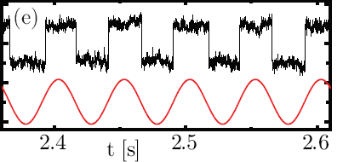



Dissipated work and fluctuation relations in driven tunneling
Jukka Pekola, Low Temperature Laboratory (OVLL),
Aalto University, Helsinki
in collaboration with
Dmitri Averin (SUNY),
Olli-Pentti Saira, Youngsoo Yoon,
Tuomo Tanttu, Mikko Möttönen,
Aki Kutvonen, Tapio Ala-Nissila,
Paolo Solinas

Slide 2
Contents:
Fluctuation relations (FRs) in classical systems, examples from experiments on molecules
Statistics of dissipated work in single-electron tunneling (SET), FRs in these systems
Experiments on Crooks and Jarzynski FRs
Quantum FRs? Work in a two-level system

Slide 3
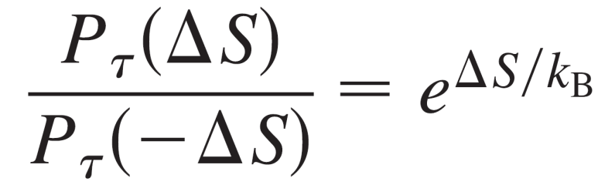
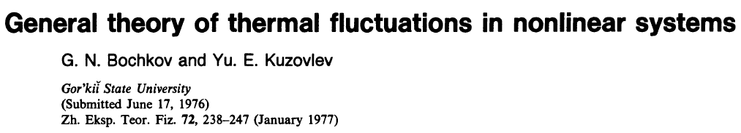
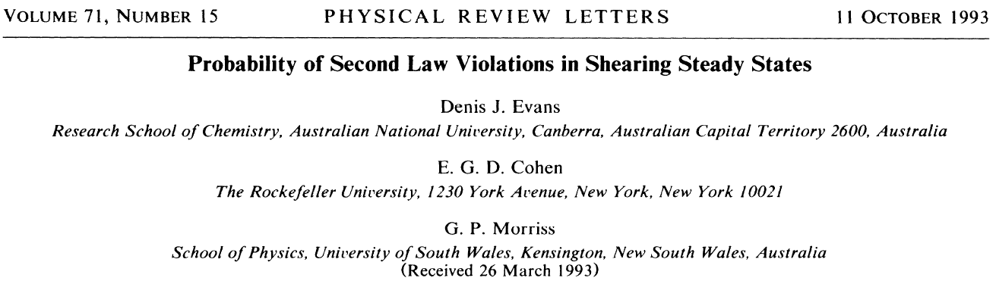
Fluctuation relations

Slide 4
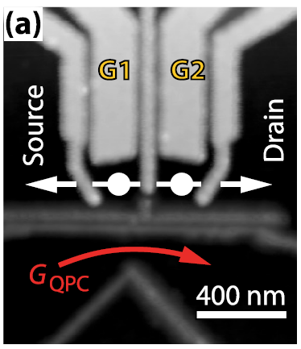
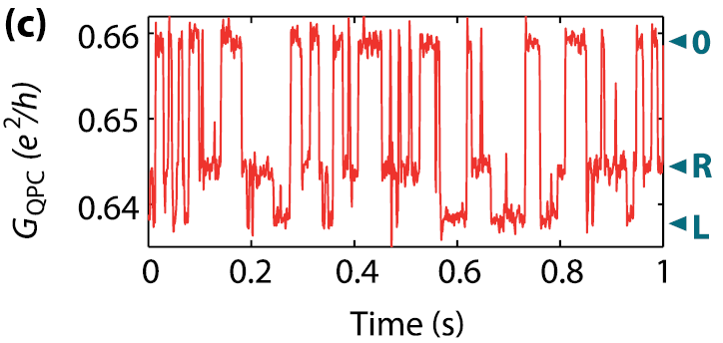
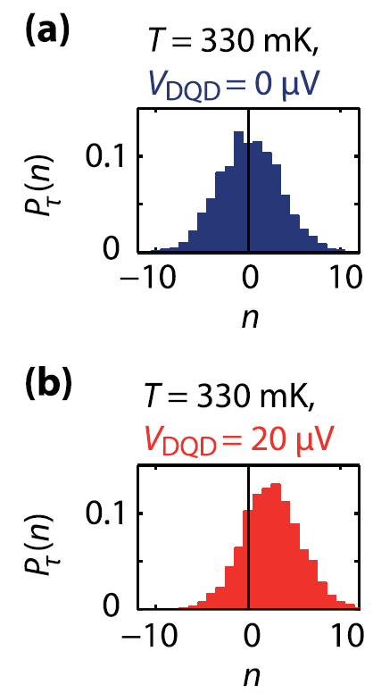
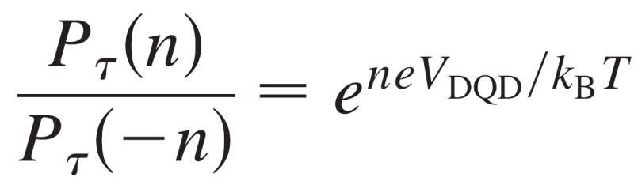
FR in a ”steady-state” double-dot circuit
B. Kung et al., PRX 2, 011001 (2012).

Slide 5

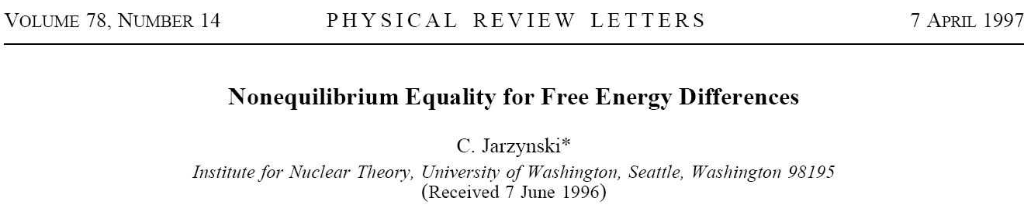
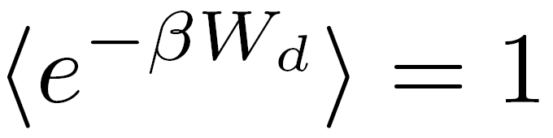
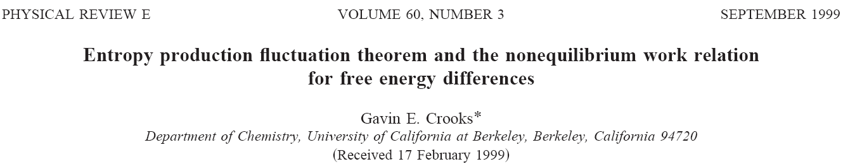
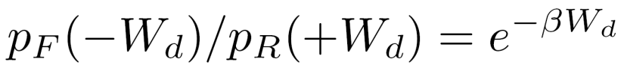
Crooks and Jarzynski fluctuation relations
F_{B}
Systems driven by control parameter(s), starting at equilibrium
”dissipated work”
F_{A}

Slide 6
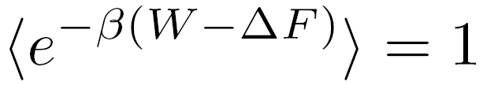


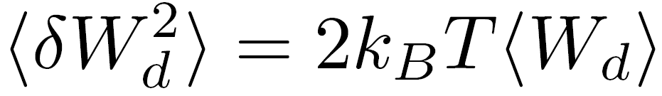
Jarzynski equality
F_{B}
Powerful expression:
1. Since
The 2nd law of thermodynamics follows from JE
2. For slow drive (near-equilibrium fluctuations) one obtains the FDT by expanding JE
where
F_{A}

Slide 7
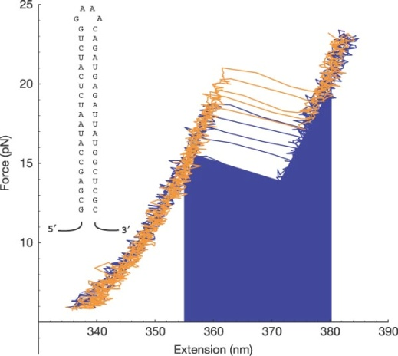
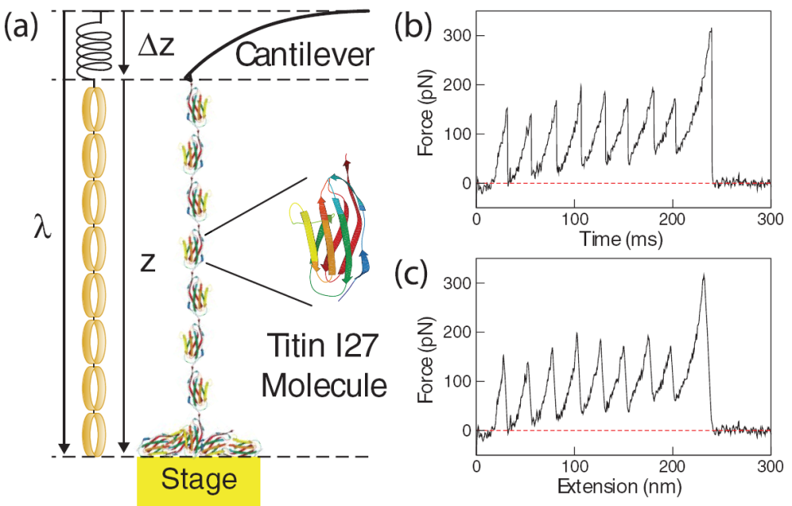
Experiments on fluctuation relations: molecules
Liphardt et al., Science 292, 733 (2002)
Collin et al., Nature 437, 231 (2005)
Harris et al, PRL 99, 068101 (2007)

Slide 8
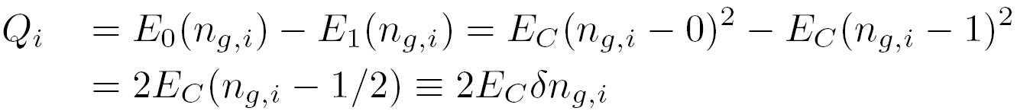
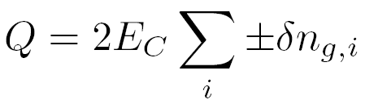

Dissipation in driven single-electron transitions
C
n
C_{g}
1
1
n_{g}
n
V_{g}
0
Single-electron box
0
0
τ
0
τ
time
time
The total dissipated heat in a ramp:
n = 0
n = 1
D. Averin and J. P., EPL 96, 67004 (2011).

Slide 9
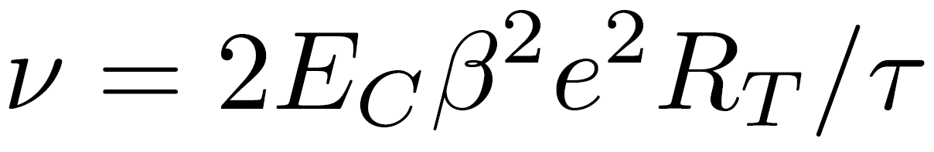
Distribution of heat
Take a normal-metal SEB
with a linear gate ramp
1
n_{g}
0
0
τ
time
ν = 0.1, 1, 10 (black, blue, red)

Slide 10
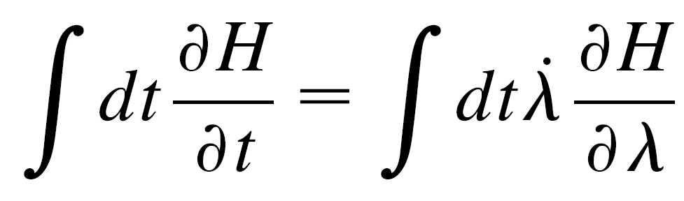
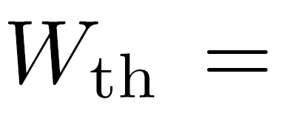
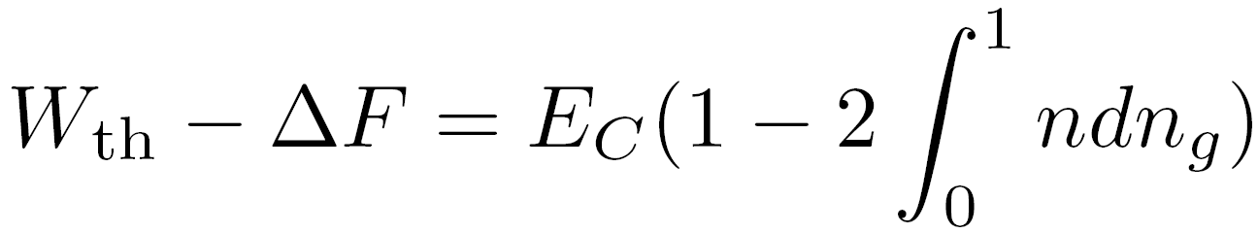
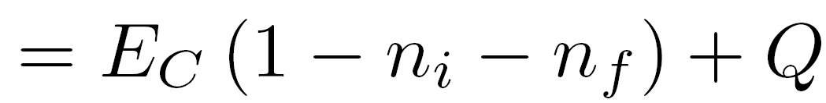
Work done by the gate
J. P. and O.-P. Saira, arXiv:1204.4623
In general:
For a SEB box:
for the gate sweep 0 -> 1
This is to be compared to:

Slide 11
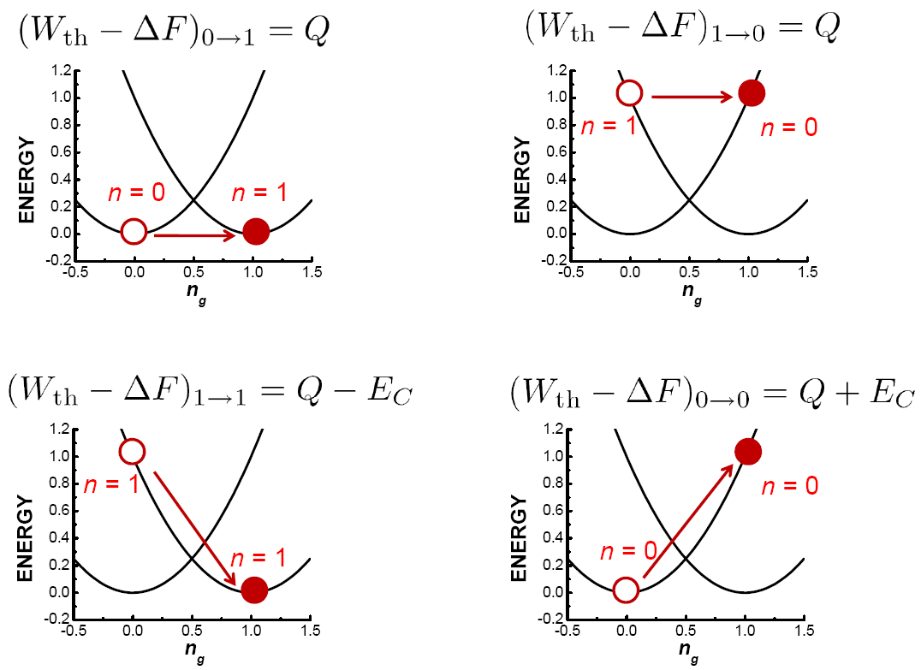
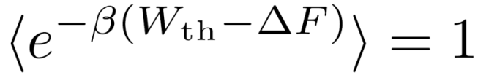
Single-electron box with a gate ramp
For an arbitrary (isothermal) trajectory:

Slide 12
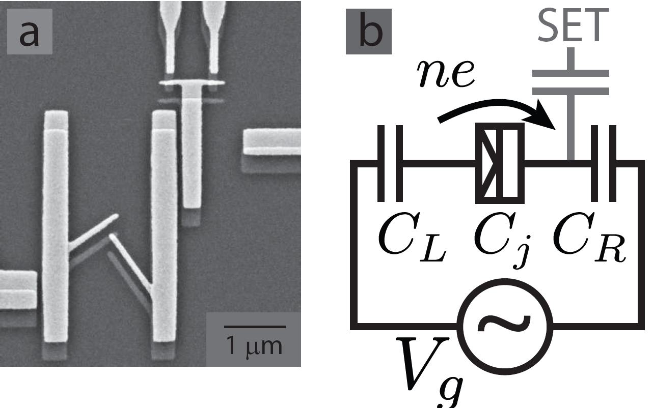
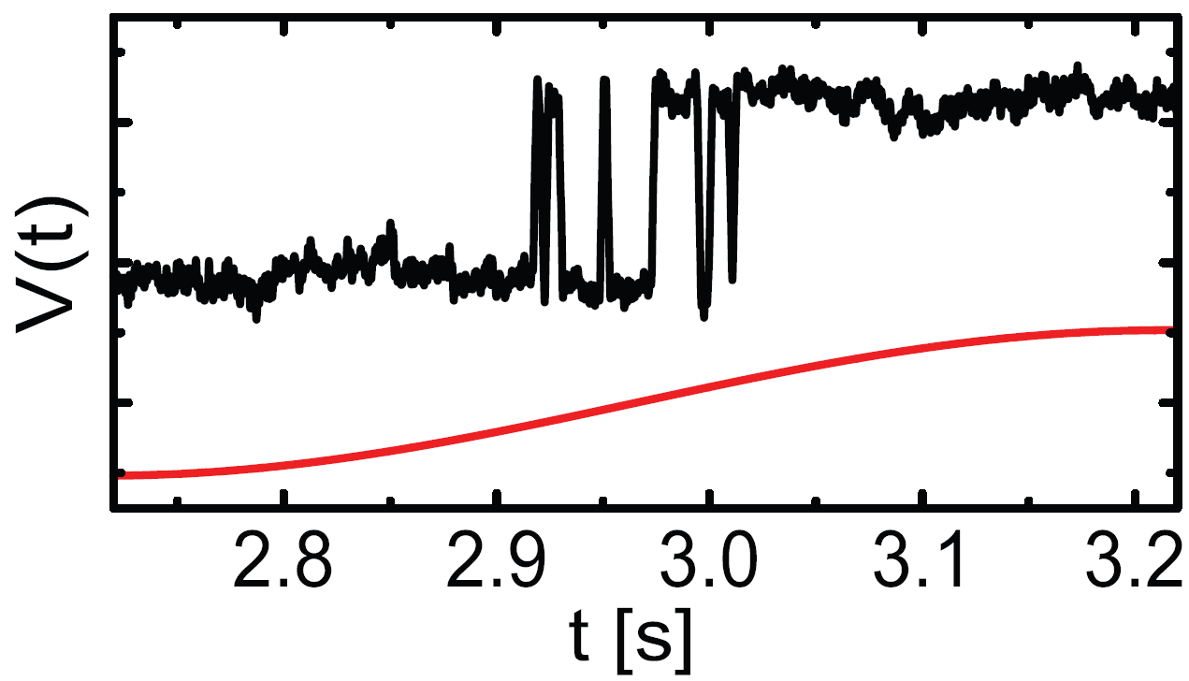

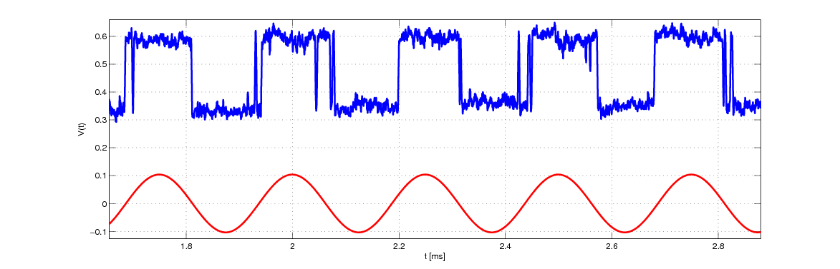
Experiment on a single-electron box
O.-P. Saira et al., submitted (2012)
Detector current
Gate drive
TIME (s)

Slide 13
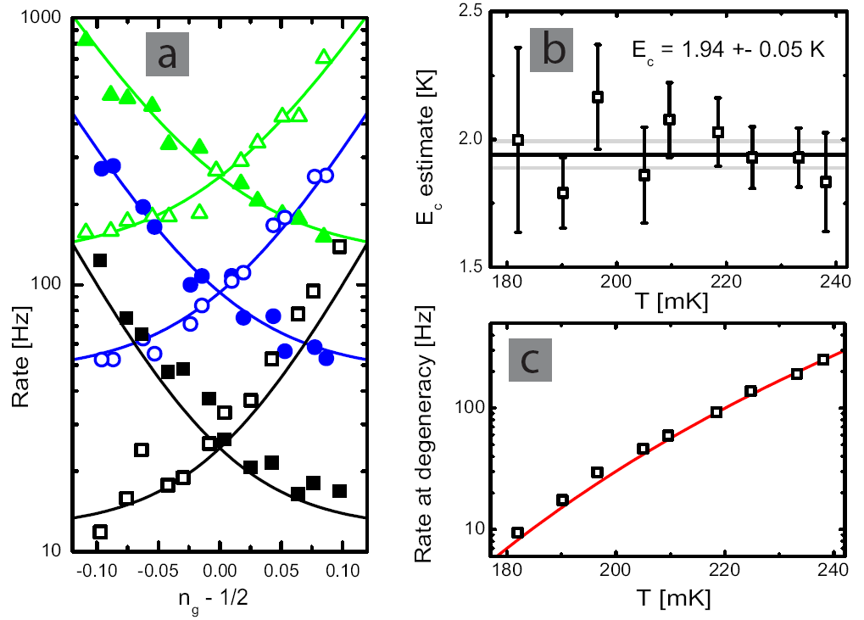
Calibrations

Slide 14
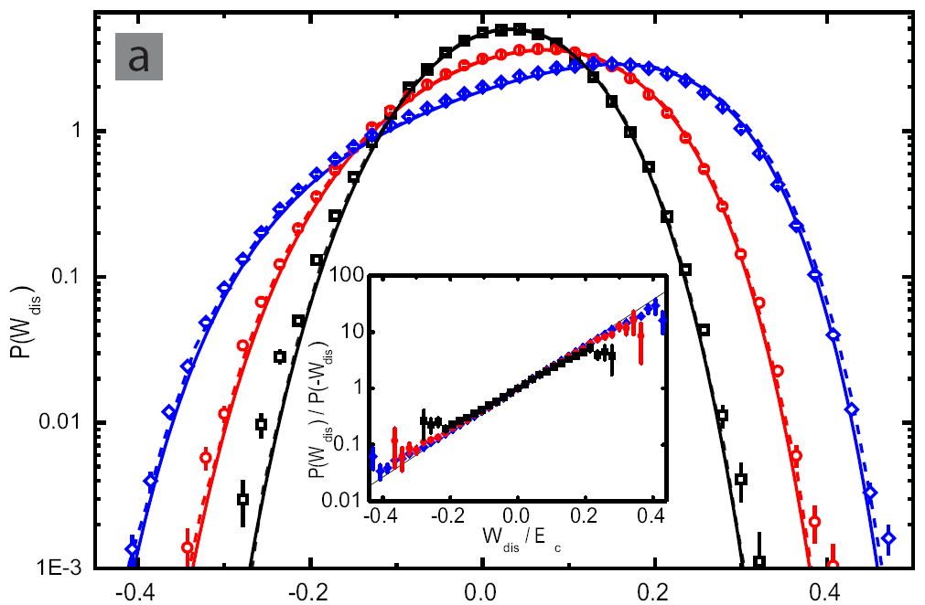
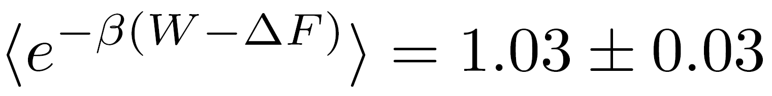
Experimental distributions
T = 214 mK
P(Q)
P(Q)/P(-Q)
Q/E_{C}
Q/E_{C}
Measured distributions of Q at three different ramp frequencies
Taking the finite bandwidth of the detector into account (about 1% correction) yields

Slide 15
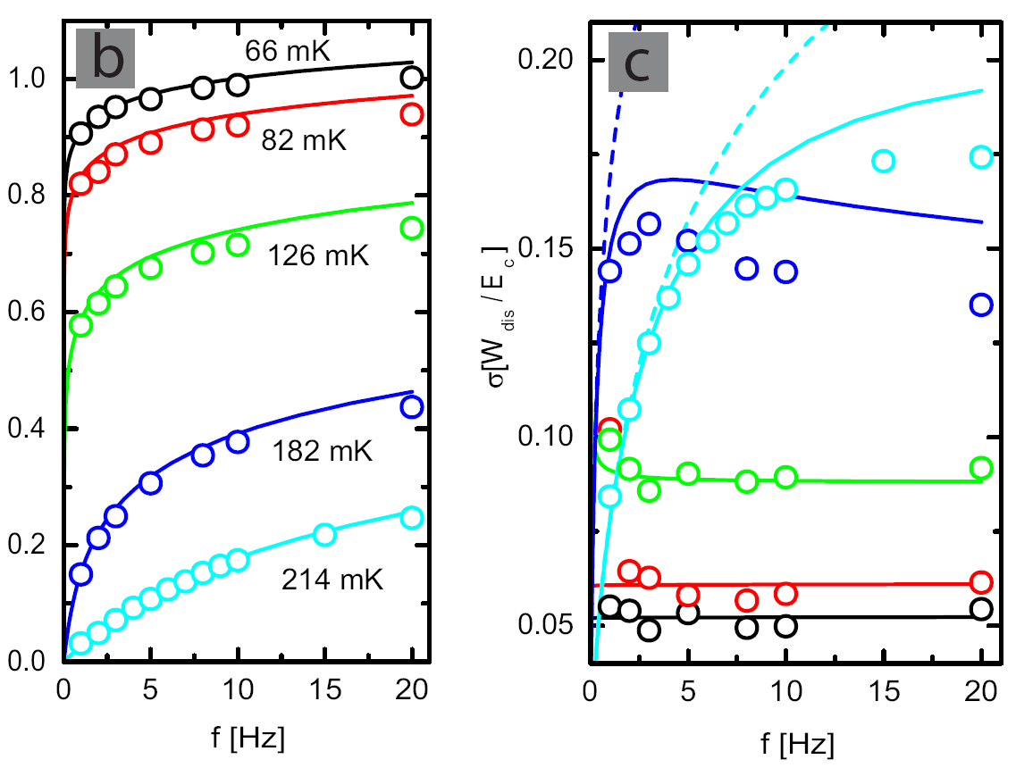

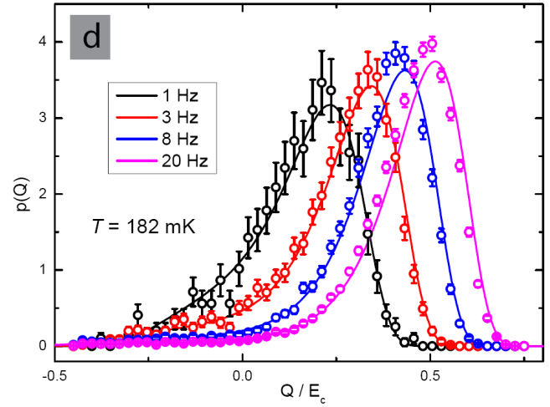
Measurements of the heat distributions at various frequencies and temperatures
symbols: experiment; full lines: theory; dashed lines:
<Q>/E_{C}
σ_{Q} /E_{C}

Slide 16
Quantum FRs ?

Slide 17
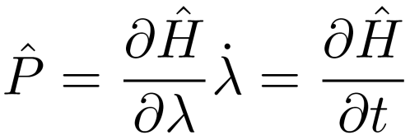
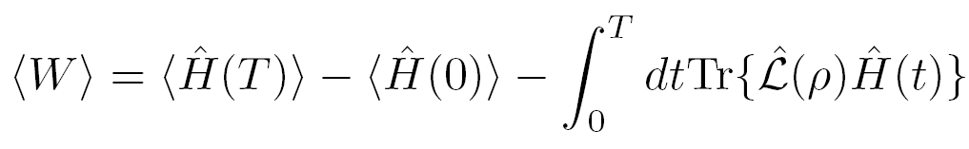
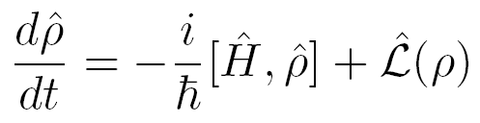
Work in a driven quantum system
P. Solinas et al., in preparation
With the help of the power operator :
Work = Internal energy + Heat
Quantum FRs have been discussed till now essentially only for closed systems
(Campisi et al., RMP 2011)

Slide 18
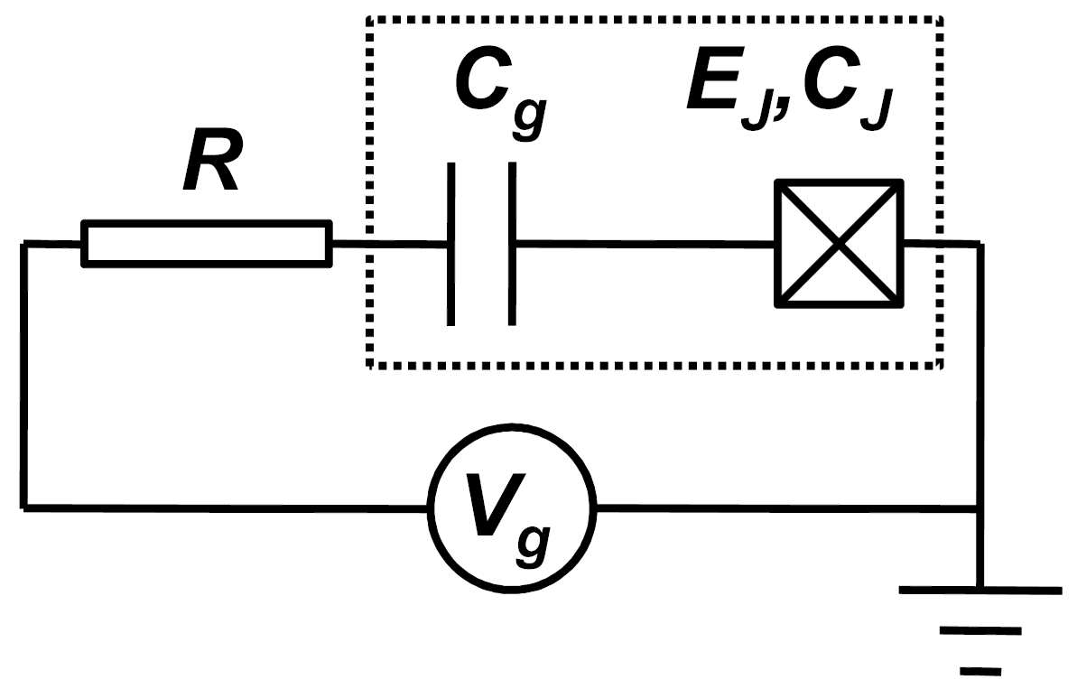
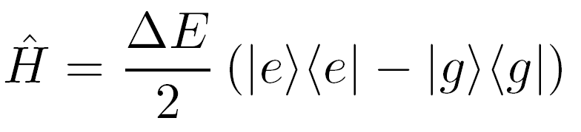
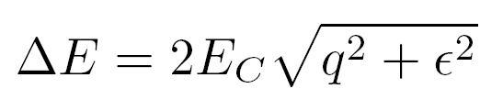
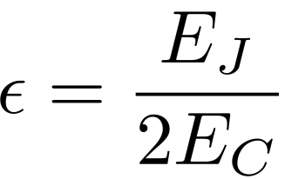
A basic quantum two-level system: Cooper pair box
In the basis of adiabatic eigenstates:
In the charge basis:

Slide 19
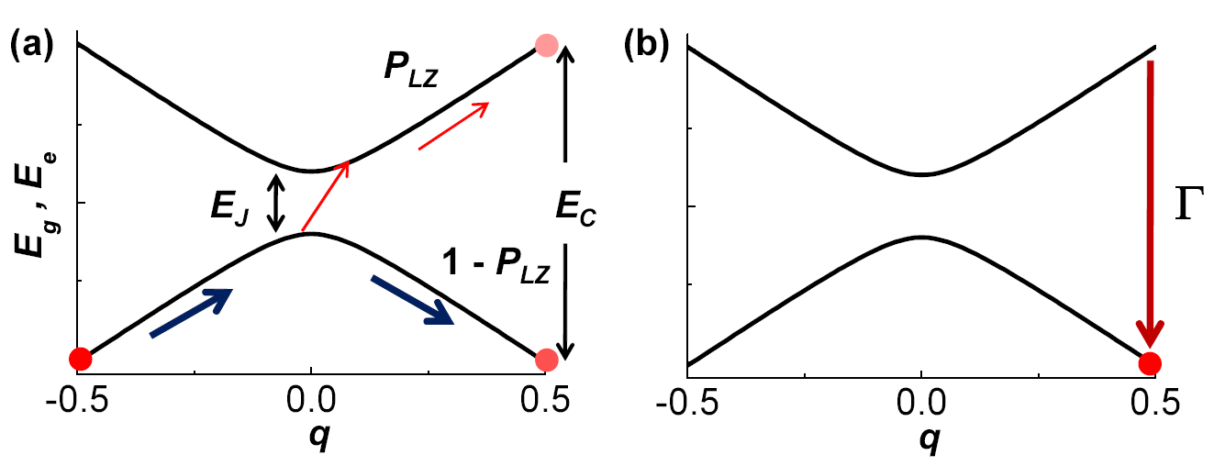

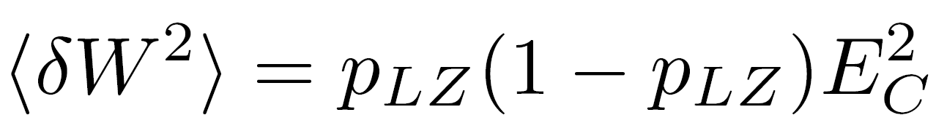
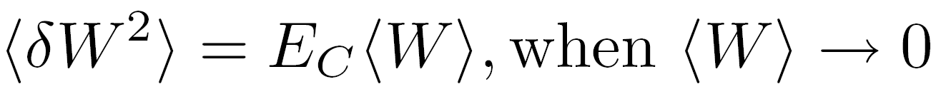
Quantum ”FDT”
Unitary evolution of a two-level system during the drive
(Γτ << 1)
in classical regime at finite T

Slide 20
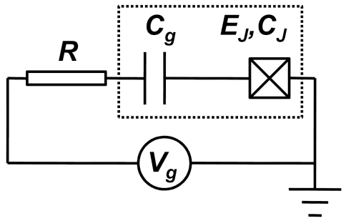
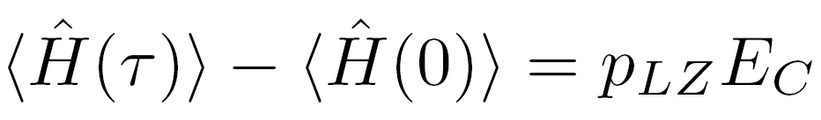
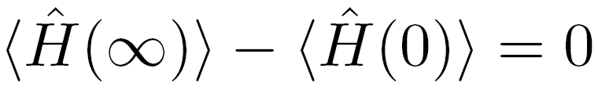



Relaxation after driving
Internal energy
Heat

Slide 21
Measurement of work distribution of a two-level system (CPB)
Calorimetric measurement:
Measure temperature of the resistor after relaxation.
”Typical parameters”:
ΔT_{R} ~ 10 mK over 1 ms time
T_{R}
TIME

Slide 22
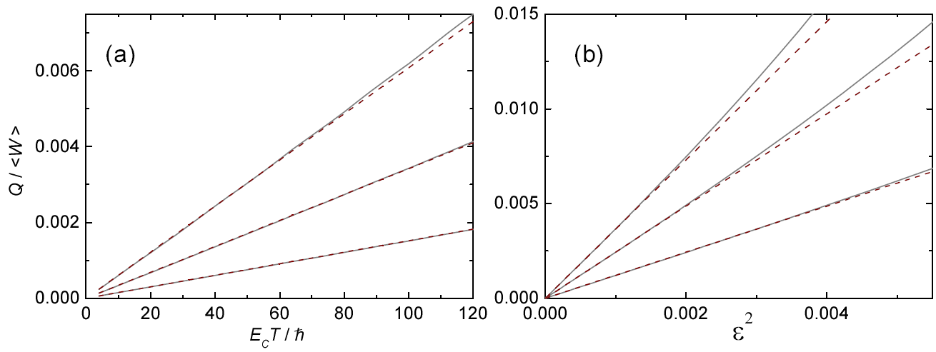

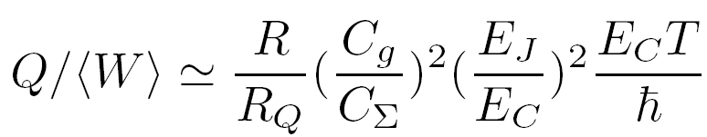
Dissipation during the gate ramp
various ε
various T
Solid lines: solution of the full master equation
Dashed lines:

Slide 23
Summary
Work and heat in driven single-electron transitions analyzed
Fluctuation relations tested analytically, numerically and experimentally in a single-electron box
Work and dissipation in a quantum system: superconducting box analyzed

Slide 24

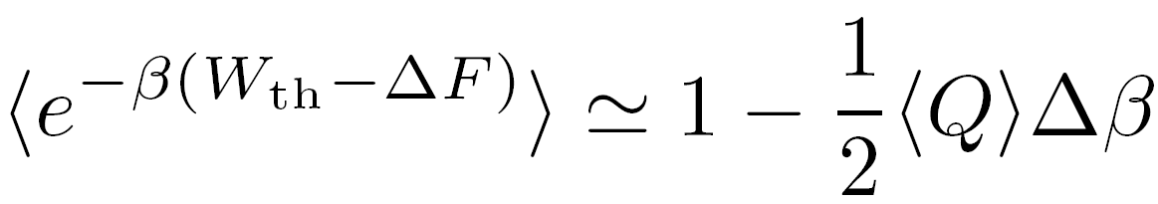
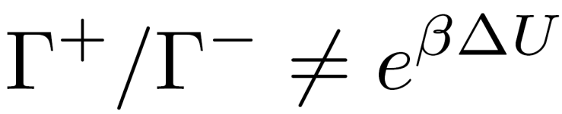
Single-electron box with an overheated island
J. P., A. Kutvonen, and T. Ala-Nissila, arXiv:1205.3951
Linear or harmonic drive across many transitions
Γ⁺
T
T_{box}
Γ⁻
T

Slide 25


Back-and-forth ramp with dissipative tunneling
System is initially in thermal equilibrium with the bath
1
n_{g}
E
0
0
τ
2τ
Δβ
1st tunneling
2nd tunneling
0
time

Slide 26









Integral fluctuation relation
U. Seifert, PRL 95, 040602 (2005).
G. Bochkov and Yu. Kuzovlev, Physica A 106, 443 (1981).
In single-electron transitions with overheated island:
Inserting we find that
is valid in general.

Slide 27

Preliminary experiments with un-equal temperatures
T_{H}
P(Q)
T_{N}
T_{S}
T₀
Coupling to two different baths
Q/E_{C}

Slide 28
Maxwell’s demon

Slide 29
Negative heat
Possible to extract heat from the bath
Provides means to make Maxwell’s demon using SETs

Slide 30



Maxwell’s demon in an SET trap
n
D. Averin, M. Mottonen, and J. P., PRB 84, 245448 (2011)
Related work on quantum dots: G. Schaller et al., PRB 84, 085418 (2011)
”watch and move”
S. Toyabe et al., Nature Physics 2010

Slide 31



Demon strategy
Adiabatic ”informationless” pumping: W = eV per cycle
Ideal demon: W = 0
n
Energy costs for the transitions:
Rate of return (0,1)->(0,0) determined by the energy ”cost” –eV/3. If Γ(-eV/3) << τ⁻¹, the demon is ”successful”. Here τ⁻¹ is the bandwidth of the detector. This is easy to satisfy using NIS junctions.
Power of the ideal demon:

