Slide 1
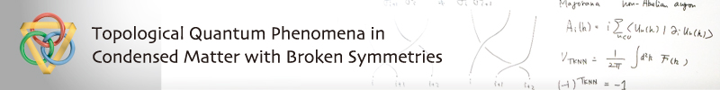
Tunneling Conductance and Surface States Transition in Superconducting Topological Insulators
http://www.topological-qp.jp/english/index.html
Yukio Tanaka (Nagoya University)
Chernogolovka June 17 (2012)

Slide 2
Main collaborators
Theory
Y. Asano （Hokkaido）
A. Golubov (Enshede)
A. Yamakage (Nagoya)
K. Yada (Nagoya)
M. Sato（Nagoya）
T. Yokoyama（Tokyo）
N. Nagaosa（Tokyo）
M. Ueda（Tokyo）
Y. Tanuma(Akita）
Y. Nazarov(Delft)
M. Sigrist (ETH)
Y. Fominov (Landau Institute)
J. Linder (Tronheim)
S. Kawabata(AIST)
Experiment
S. Kashiwaya （AIST）
Y. Maeno (Kyoto)
Y. Ando (Osaka)
M. Koyanagi (AIST)

Slide 3
(1) Theory of Tunneling Conductance in Superconducting Topological Insulator
A. Yamakage, K. Yada, M. Sato and Y. Tanaka
Phys. Rev. B 85 180509(R) 2012
(2) Majorana fermion and odd-frequency Cooper pair
Y. Asano and Y. Tanaka
arXiv: 1204.4226

Slide 4
Surface Andreev bound state (ABS) up to now
(1)d-wave (cuprate)
(2)chiral p-wave (Sr₂RuO₄)
(3)helical (NCS superconductor)
(4)3d superconductor (superfluid ³He)
The presence of ABS is supported by the bulk topological invariant.
Y. Tanaka, M. Sato and N. Nagaosa, J. Phys. Soc. Jpn. 81 011013 (2012)

Slide 5

Tunneling effect in unconventional superconductors
Unconventional
superconductor
s-wave
Normal
metal
Cuprate
？
Important issue of
cuprate in the 90s.

Slide 6


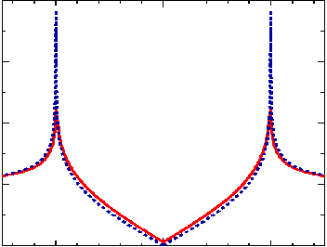
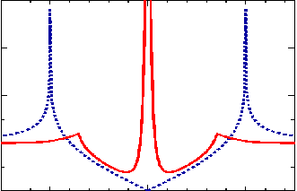


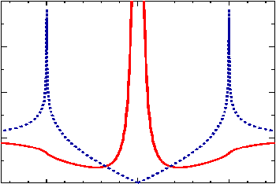

Tunneling conductance in d-wave junction
Y. Tanaka & S. Kashiwaya: Phys. Rev. Lett. 74 (1995) 3451.
Normal metal
d-wave
superconductor
angle between the normal to the interface and the lobe direction
Bulk ldos (blue line）
Zero bias conductance peak
Andreev bound state
Surface zero energy state
L. Buchholtz & G. Zwicknagl : Phys. Rev. B 23 (1981) 5788.
J. Hara & K. Nagai : Prog. Theor. Phys. 74 (1986) 1237.
C.R. Hu : Phys. Rev. Lett. 72 (1994) 1526.

Slide 7
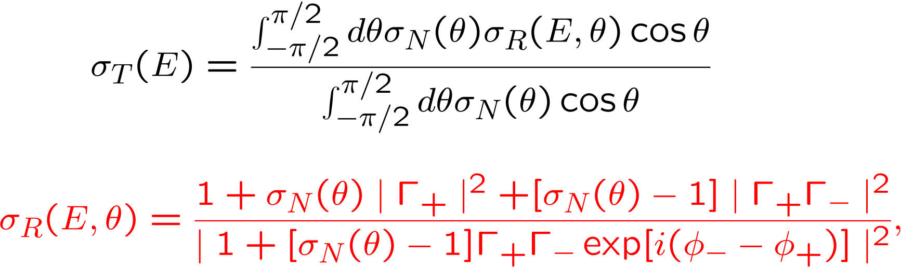
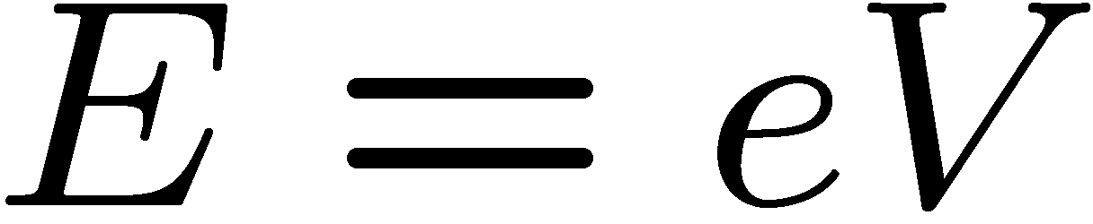
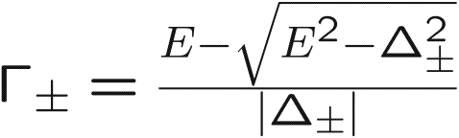
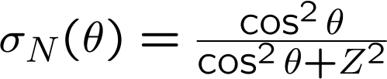
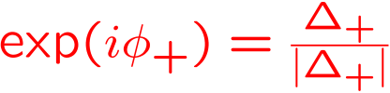

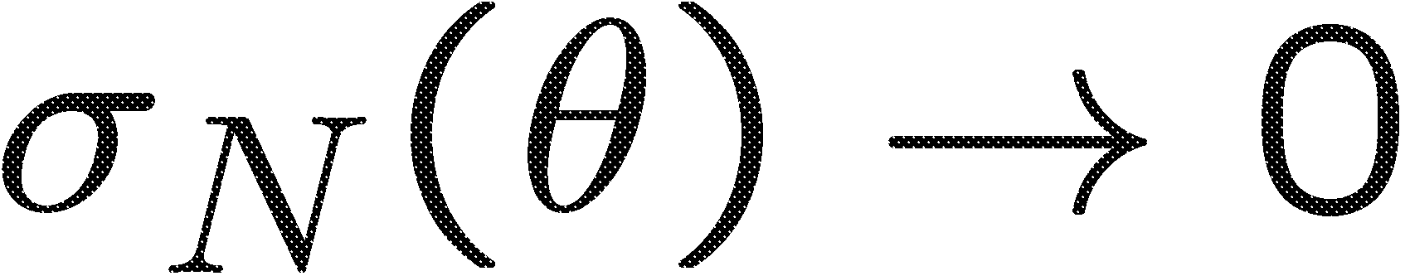
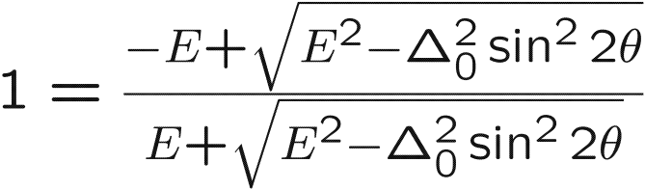
Conductance formula in unconventional superconductor
（Tanaka and Kashiwaya PRL 74 3451)
Bruder (1990)
Blonder Tinkham
Klapwijk (1982)
transparency
Condition for ABS
Flat zero energy band
surface
C.R. Hu : Phys. Rev. Lett. 72 (1994) 1526.

Slide 8
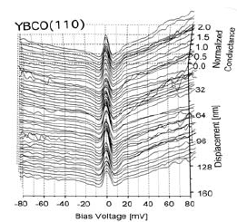

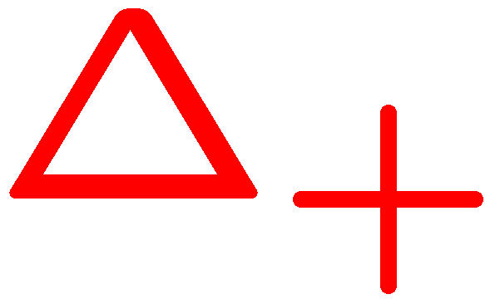
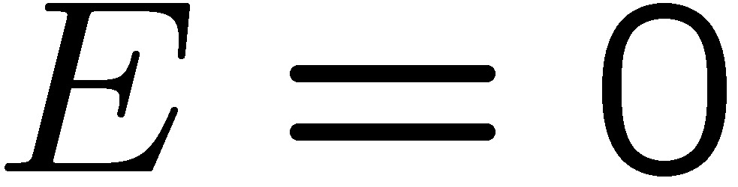
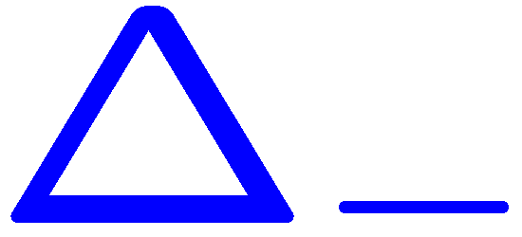
Well known example of Andreev bound states in d-wave superconductor
y
Phase change of pair potential is π
ABS in d-wave
(110)direction
ー
＋
k_{y}
＋
ー
Flat dispersion!!
Zero energy
Tanaka Kashiwaya PRL 74 3451 (1995),
Kashiwaya, Tanaka, Rep. Prog. Phys. 63 1641 (2000)
Hu(1994) Matsumoto Shiba(1995)
Surface
Notes:
I would like to explain the MARS by considering an elementary scattering process expected at the interface of
Normal metal / unconventional superconductor junctions.
Here, we choose d-wave pair potential as an example.
An injected electron from the left side is reflected as an electron by the normal reflection and
Transmitted into superconductor as an electron like quasiparticle.
reflected as an hole by the so called Andreev reflection.
On the other hand an electron is transmitted as an electron like quasiparticle and hole like quasiparticle.
The effective pair potentials felt by electron-like and hole-like quasiparticles are
denoted as \Delta_{+} and \Delta_{-}.
It was established that when the sign of $\Delta_{+}\Delta_{-}$ is negative,
we can expect MARS. MARS influences seriously on several charge transport.

Slide 9
Surface Andreev bound state (ABS) up to now
(1)d-wave (cuprate)
(2)chiral p-wave (Sr₂RuO₄)
(3)helical (NCS superconductor)
(4)3d superconductor (superfluid ³He)
The presence of ABS is supported by the bulk topological invariant.
Y. Tanaka, M. Sato and N. Nagaosa, J. Phys. Soc. Jpn. 81 011013 (2012)

Slide 10
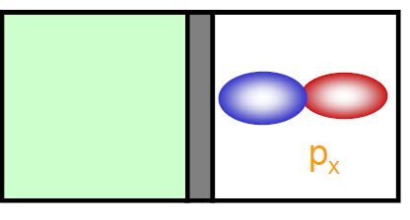
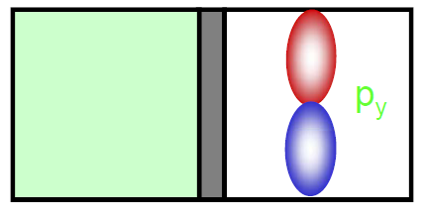
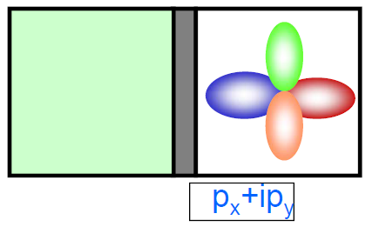
Extension to spin-triplet superconductor
Normal metal
superconductor
Phys. Rev. B. 56, 7847 (1997)
J. Phys. Soc. Jpn. 67, 3224 (1998)
L. Buchholtz & G. Zwicknagl : Phys. Rev. B 23 (1981) 5788.
J. Hara & K. Nagai : Prog. Theor. Phys. 74 (1986) 1237

Slide 11
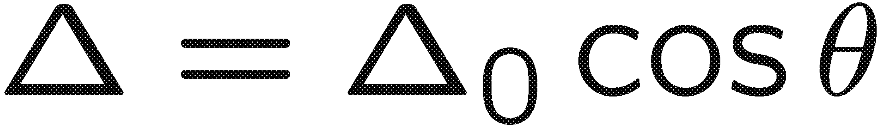
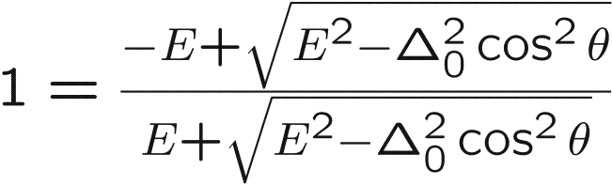

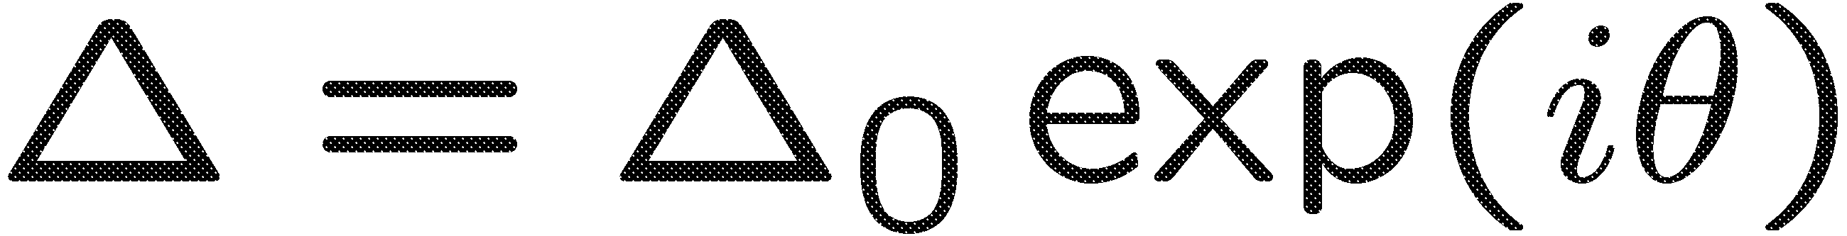
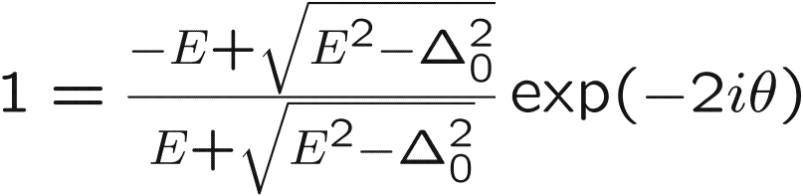
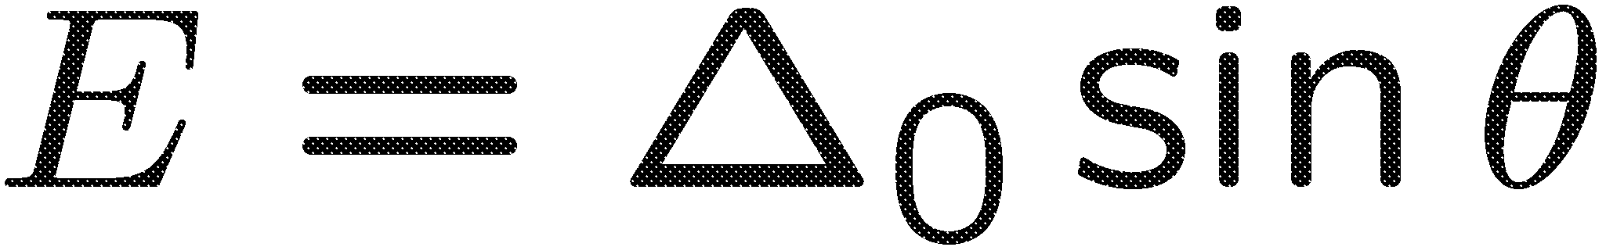
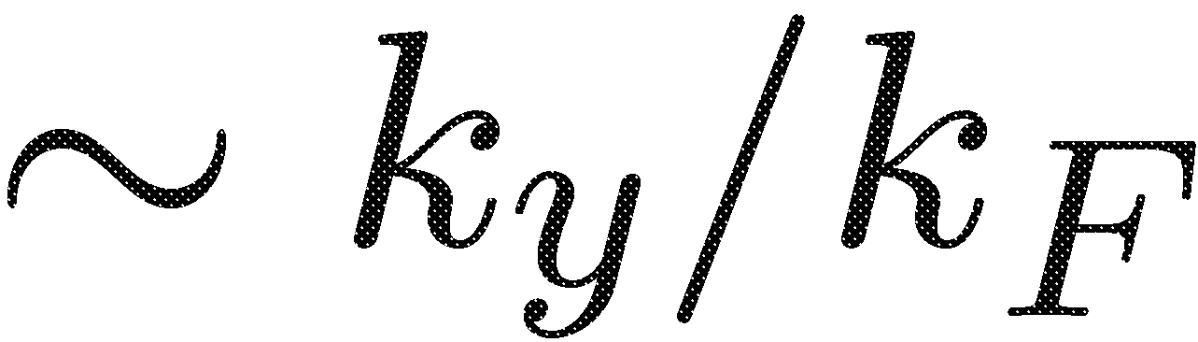
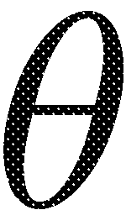
Condition for ABS
p_{x}
flat dispersion
surface
chiral p
surface
linear dispersion

Slide 12
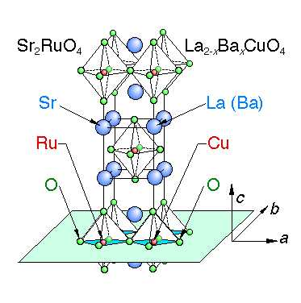
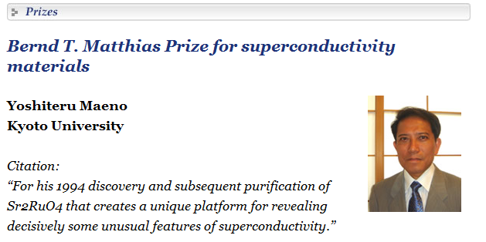
Chiral superconductor Sr₂RuO₄
Edge surface current
Similar structure to cuprate
Maeno (1994)

Slide 13
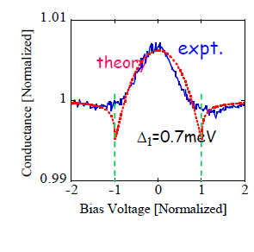
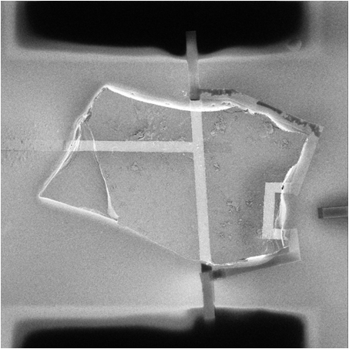

Recent experiment of Sr₂RuO₄
S/I/N
Experiment
Sr₂RuO₄
Au
SiO₂
It is possible to fit experimental data taking into account of anisotropy of pair potential.
S. Kashiwaya, et al,
Phys. Rev. Lett. 107, 077003 (2011)

Slide 14
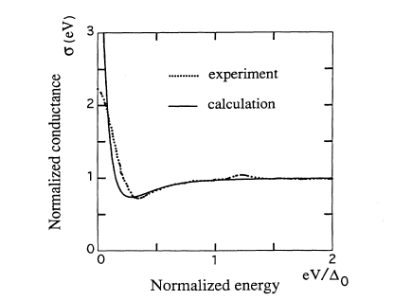
Tunneling spectrum in two-dimensional topological superconductors
S.Kashiwaya, 1995
E/Δ
Angle resolved
conductance
Δ
d_{x2-y2}-wave
nodal gap
YBCO(110)
−Δ
zero energy flat band
of surface states
Δ
θ/π
Injected angle
Sr₂RuO₄
chiral p-wave
full gap
chiral edge state
broad zero-bias peak
due to linear dispersion
E/Δ
theory
Δ
expt.
−Δ
Δ
θ/π
Kashiwaya et al, Phys. Rev. Lett. 107, 077003 (2011)
Injected angle

Slide 15
Surface Andreev bound state (ABS) up to now
(1)d-wave (cuprate)
(2)chiral p-wave (Sr₂RuO₄)
(3)helical (NCS superconductor)
(4)3d superconductor (superfluid ³He)
The presence of ABS is supported by the bulk topological invariant.
Y. Tanaka, M. Sato and N. Nagaosa, J. Phys. Soc. Jpn. 81 011013 (2012)

Slide 16
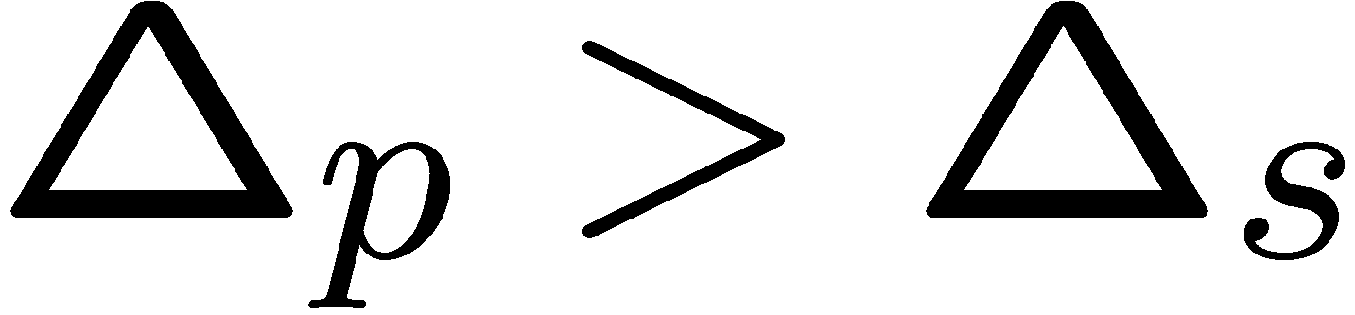
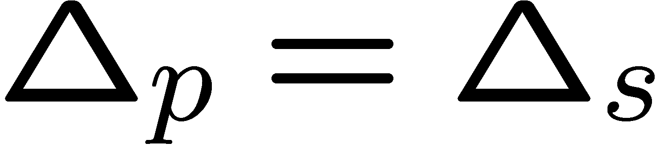
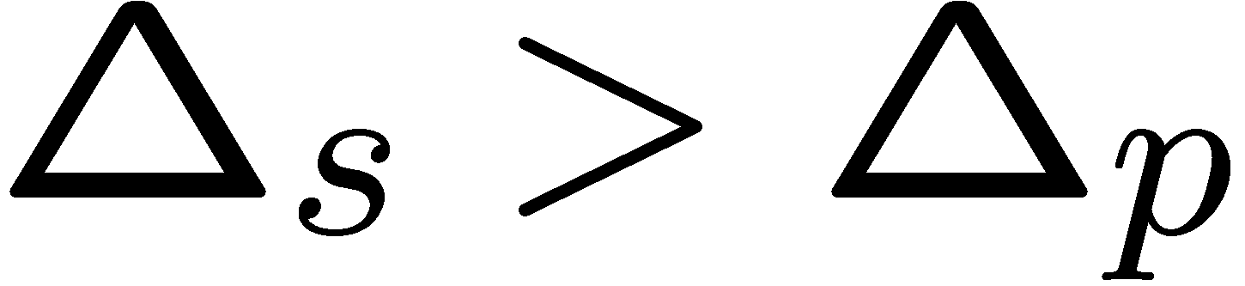
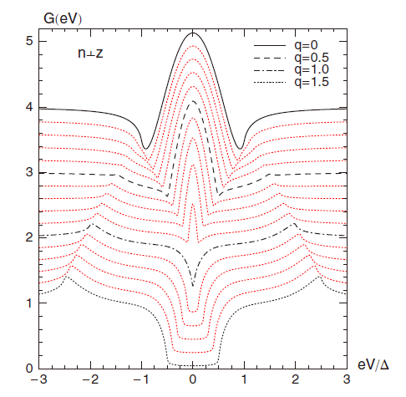
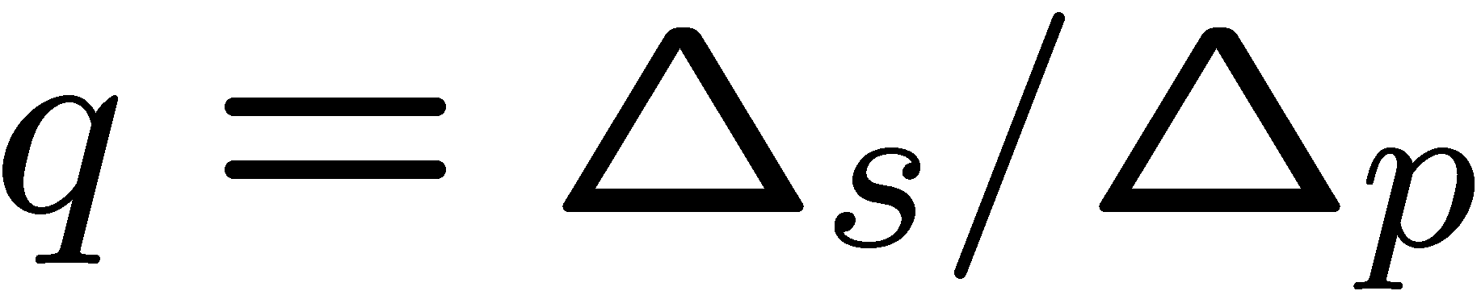
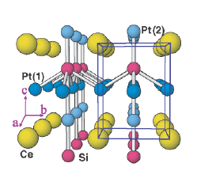
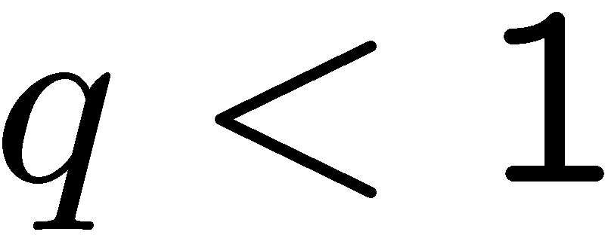
Andreev bound state in the presence of spin-orbit coupling
Spin-singlet（s-wave）Δ_{s} spin-triplet(p-wave）Δ_{p}
Andreev bound state
Bulk energy gap
No Andreev bound state
Gap closes
No Andreev bound state
Bulk energy gap
Calculated conductance
CePt₃Si
Helical superconductor
Zero bias conductance peak by Andreev bound state
Iniotakis, Tanaka et al,
Phys. Rev. B 76, 012501 (2007)

Slide 17


Feature of the Andreev bound states
Non-centrosymmetric superconductor (NCS)
d_{xy}-wave
Chiral p-wave
NCS (Helical)
-wave
p+s -wave
Hu(94)
Tanaka Kashiwaya (97)
Iniotakis (07)
Eschrig(08)
Tanaka (09)
Tanaka Kashiwaya (95)
Sigrist Honerkamp (98)
Flat
Chiral
Helical

Slide 18
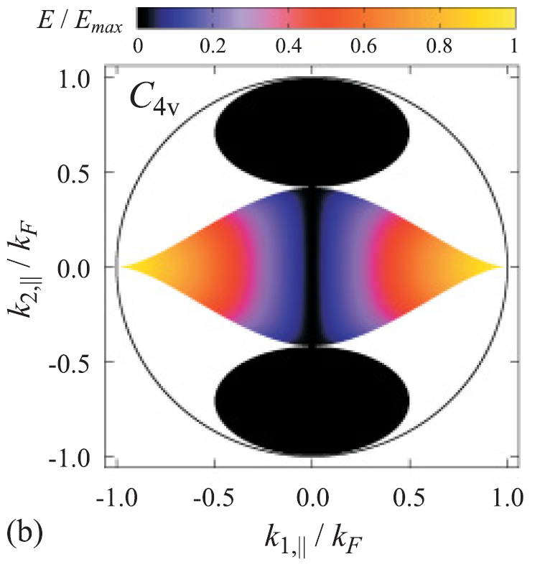
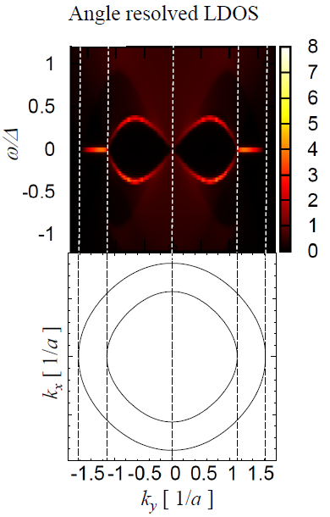
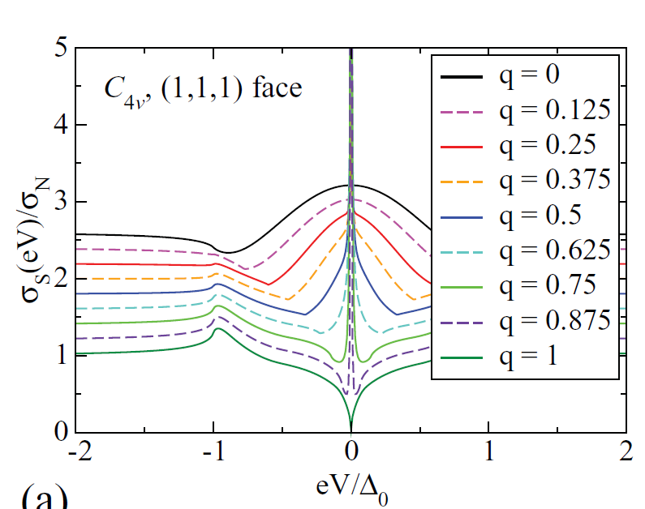
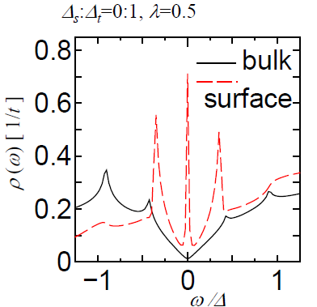
Flat dispersion of ABS in NCS superconductor
(mixing of d and p-wave pairing)
2d case
3d case
LaAlO₃
Edge
SrTiO₃
Flat ABS
one of the
Fermi surface
is absent by SO
coupling
P. M. R. Brydon et al, PRB11
K. Yada, et al, Phys. Rev. B Vol. 83 064505 (2011)

Slide 19
Superconducting Materials where zero bias conductance peak by ABS is observed
YBa₂CuO_{7-δ} (Geerk, Kashiwaya, Iguchi, Greene, Yeh,Wei..)
Bi₂Sr₂CaCu₂O_{y} (Ng, Suzuki, Greene….)
La_{2-x}Sr_{x}CuO₄ (Iguchi)
La_{2-x}Ce_{x}CuO₄ (Cheska)
Pr_{2-x}Ce_{x}CuO₄ (R.L.Greene)
Sr₂RuO₄ (Mao, Maeno, Laube,Kashiwaya)
κ−(BEDT-TTF)₂X, X=Cu[N(CN)₂]Br (Ichimura)
UBe₁₃ (Ott)
CeCoIn₅ (Wei Greene)
PrOs₄Sb₁₂ (Wei)
PuCoGa₅ (Daghero)
Superfluid ³He (Okuda, Nomura, Higashitani, Nagai)

Slide 20
Surface Andreev bound state (ABS) up to now
(1)d-wave (cuprate)
(2)chiral p-wave (Sr₂RuO₄)
(3)helical (NCS superconductor)
(4)3d superconductor (superfluid ³He)
The presence of ABS is supported by the bulk topological invariant.
Y. Tanaka, M. Sato and N. Nagaosa, J. Phys. Soc. Jpn. 81 011013 (2012)

Slide 21
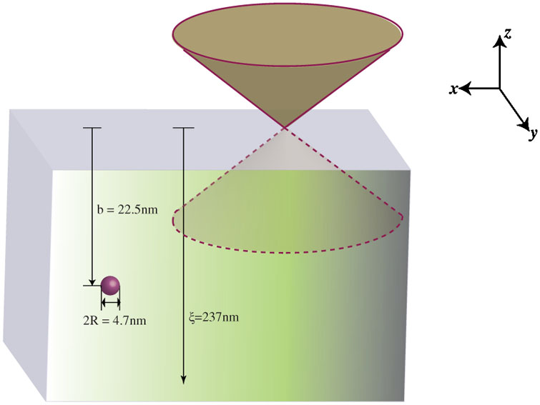
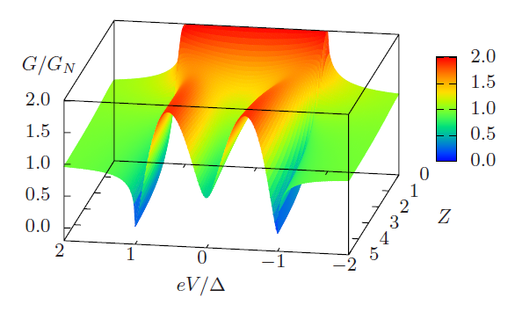
ABS in B-phase of superfluid ³He
Dirac Cone type
ABS
Salomaa Volovik (1988)
Schnyder (2008)
Roy (2008) Nagai (2009)
Qi (2009)
Kitaev(2009)
Chung, S.C. Zhang (2009)
Volovik (2009)
perpendicular injection ZES: Buchholtz and Zwicknagle (1981)
BW state (B-phase in ³He)
full gap superconductor
y
Metal
BW
x
tunneling conductance
z
z=0
no zero-bias peak
due to linear dispersion
of surface states
barrier
bias-voltage
Y. Asano et al, PRB ’03

Slide 22
ABS and tunneling conductance
space dimension | gap structure |  | surface state | tunneling conductance
2D | nodal |  | flat band | zero-bias peak
 | full |  | chiral/helical
3D | nodal |  | flat band
 | full | BW | helical | double peak
 |  | superconducting topological insulator |  | ?
Motivation
To clarify tunneling conductance in new type of three-dimensional
topological superconductor (superconducting topological insulator).

Slide 23
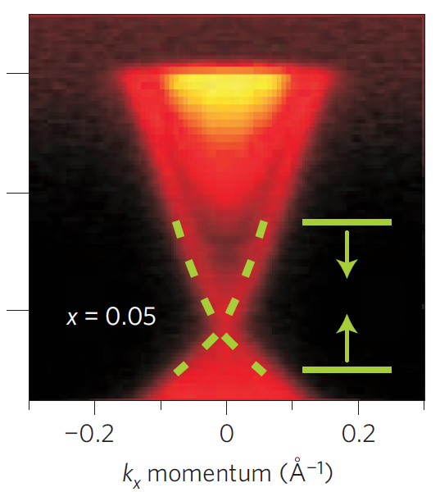
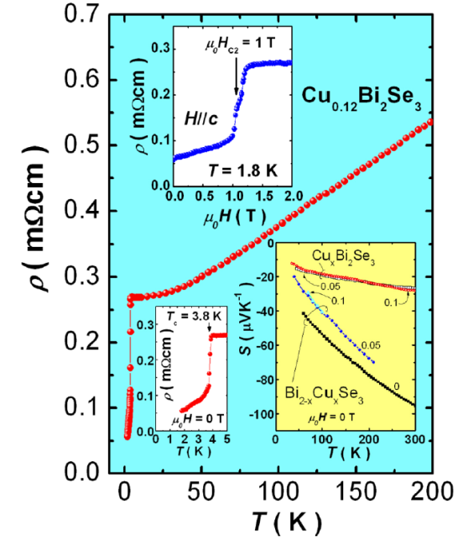
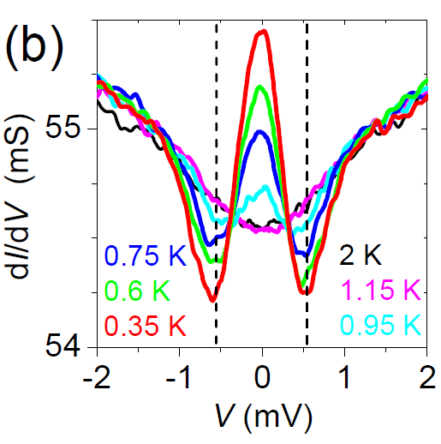
Superconducting topological insulator
topological insulator
……metallic surface states
superconducting topological insulator
Cu_{x}Bi₂Se₃
tunneling conductance
(point contact)
Y. S. Hor et al, PRL ’10
S. Sasaki et al, PRL ’11
surface
states
zero-bias peak⇒gapless surface states
L. A. Wray et al, Nature Phys. 10
new type of three-dimensional
topological superconductor

Slide 24
Superconductivity on the surface states
spin-triplet superconducting gap
in bulk not in surface
energy
bulk
surface
momentum
L. Hao and T. K. Lee, PRB 2011, T. H. Hsieh and L. Fu, PRL 2012

Slide 25
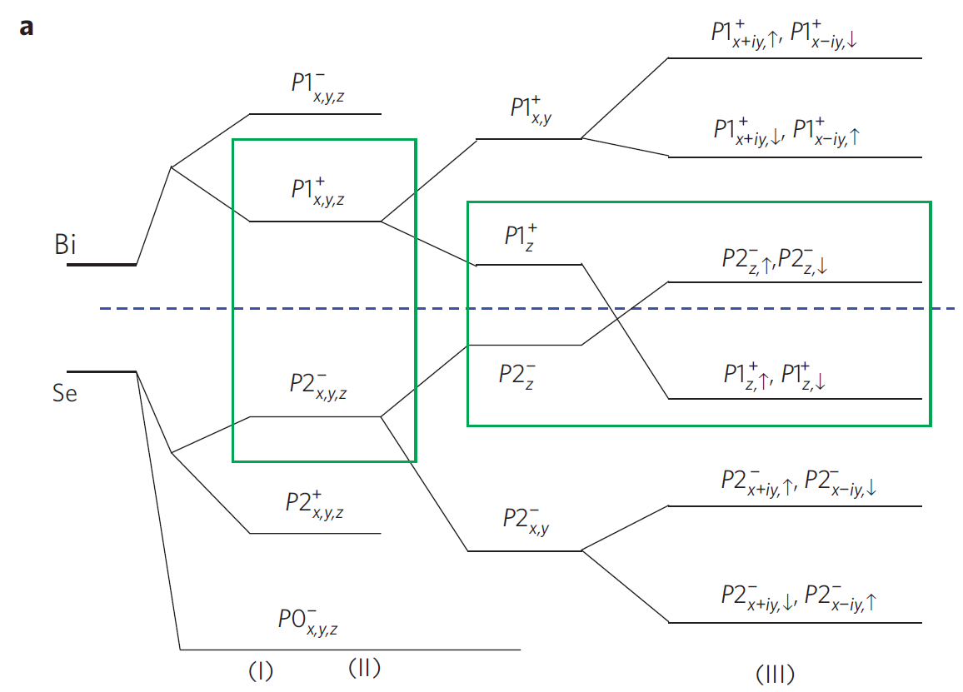
Electronic states of Bi₂Se₃
two low-energy effective orbitals
Se1
Bi1
Se2
Bi2
Se3
energy levels of the atomic orbitals
in Bi₂Se₃
unit cell of Bi₂Se₃
Zhang et al, Nature 09

Slide 26


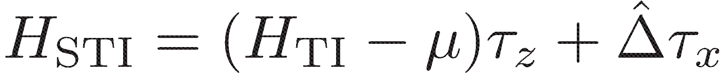
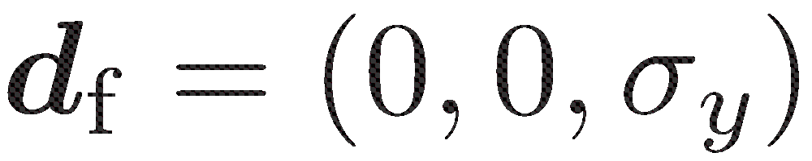
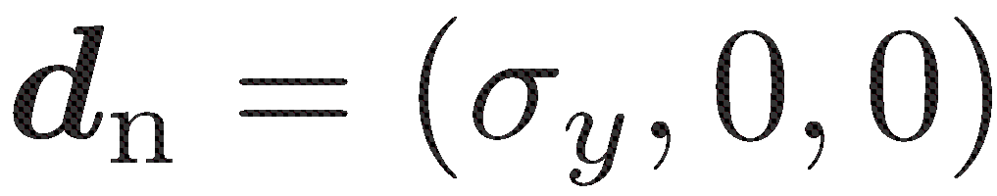
Hamiltonian of a superconducting topological insulator
Hamiltonian of the parent topological insulator
：orbital (spin)
：spin
Hamiltonian of a superconducting topological insulator
[111] // z
for Bi₂Se₃
s-wave spin-triplet (orbital-singlet) superconductor
（supporting gapless surface states）
full gap
point nodes
L. Fu and E. Berg, PRL ’10

Slide 27
Candidate of Cu_{x}Bi₂Se₃
Liang Fu, Erez Berg, PRL,105, 097001 (2010)
Pair potential proposed by Fu and Berg
 | Energy gap | spin | Orbit
Δ₁ | full gap | singlet | intra
Δ₂ | full gap | triplet | inter
Δ₃ | point node along k_{z} direction | singlet | intra
Δ₄ | point node along k_{x} direction | triplet | inter
p_{z} orbital
unit cell
Cu
Se
or
Bi
Se
Se
Bi
Bi
Se
Se
Bi
Se
Intra-orbital
Inter-orbital
Cu
(orbital triplet)
(orbital singlet)
Cu_{x}Bi₂Se₃ Effective orbital p_{z} orbital (No momentum dependence)
Notes:
また、カッパービスマスの特徴としてユニットセル内に2つの有効軌道があることが知られて
この二つの軌道に対して、同じ軌道で組むのか、違う軌道で組むのかという自由度も現れてきます
まず、ペアの組み方ですが
FuとBergにより4つのペアが提案されています。結晶の対称性やスピン軌道相互作用を考えた結果4つになっています
一つ目は従来型BCS超伝導に多くみられるfull gapでsingletのペア
２つ目・・・
3つ目・・・
4つ目・・・
また、CuBiSeの特徴として、フェルミ面近傍に2つの有効軌道(ｐ軌道）があります
なので、同じサイト内ですが、同じ軌道内で組んでいるのか、違う軌道間で組んでいるのかという違いも考えられています
結晶の対称性よりそれぞれシングレットとトリプレットに対応しています

Slide 28




Pairing function in superconducting topological insulator
topological insulator: two orbitals
s-wave pairing
spin singlet
spin triplet (orbital singlet)
no surface states
gapless surface states
full gap
nodal gap
full gap
nodal gap
L. Fu and E. Berg, PRL ’10

Slide 29


Surface states in topological insulators in the normal phase
surface states
at the Fermi level
on the surface
Orbital degrees of freedom
is quenched.
s-wave spin-triplet
superconducting gap
is impossible
helical surface states
J. Linder et al, PRL 10 (momentum-dependent case)
L. Hao and T. K. Lee, PRB 2011, T. H. Hsieh and L. Fu, PRL 2012
Notes:
Two orbital

Slide 30
Superconductivity on the surface states
energy spectrum of topological insulator
energy
bulk
surface
momentum
L. Hao and T. K. Lee, PRB 2011, T. H. Hsieh and L. Fu, PRL 2012

Slide 31
Superconductivity on the surface states
spin-triplet superconducting gap
in bulk not in surface
energy
energy
bulk
bulk
surface
surface
spin-triplet
superconductor
momentum
twisted spectrum
L. Hao and T. K. Lee, PRB ’11, T. H. Hsieh and L. Fu, PRL ’12
Notes:
バルクにはギャップがある。
表面にはない。

Slide 32
Structural transition of ABS
energy
energy
large chemical potential
cone
momentum
L. Hao and T. K. Lee, PRB ’11 T. H. Hsieh and L. Fu, PRL ’12
A. Yamakage, Y, K. Yada, M. Sato, and Y. Tanaka, PRB 12

Slide 33
Structural transition of ABS
energy
at transition
group velocity=0
energy
momentum
L. Hao and T. K. Lee, PRB ’11 T. H. Hsieh and L. Fu, PRL ’12
AY, K. Yada, M. Sato, and Y. Tanaka, PRB 12

Slide 34
Structural transition of ABS
energy
energy
small chemical potential
caldera
momentum
L. Hao and T. K. Lee, PRB ’11 T. H. Hsieh and L. Fu, PRL ’12
A.Yamakage, K. Yada, M. Sato, and Y. Tanaka, 2012

Slide 35



Structural transition of ABS
energy
transition
transition point:
group velocity = 0
L. Hao and T. K. Lee, PRB ’11 T. H. Hsieh and L. Fu, PRL ’12
AY, K. Yada, M. Sato, and Y. Tanaka, 2012

Slide 36

Tunneling conductance in full-gap superconducting topological insulators
full-gap case
y
Metal
STI
x
z
z=0
structural transition
-> group velocity ~ zero
-> large surface DoS
eV/Δ
zero-bias peak even in the full gap case
A. Yamakage , K. Yada, M. Sato, and Y. Tanaka, PRB2012

Slide 37
  Summary:
  Theory of tunneling spectroscopy of superconducting topological insulators
1. Zero-bias conductance peak is possible
even in full-gap topological 3d superconductors,
differently from the case of BW states.
2. This originates from the structural transition of energy dispersion of ABS.
Yamakage, Yada, Sato, and Tanaka,
Physical Review B 85 180509(R) 2012

Slide 38









Josephson effect in s-wave/STI
STI
full gap
triplet
s-wave
singlet
Josephson current
Fu and Berg, PRL 10

Slide 39




Josephson effect in d-wave/N/STI
Josephson current
irrespective of anisotropic pairings

Slide 40
(1) Theory of Tunneling Conductance in Superconducting Topological Insulator
A. Yamakage, K. Yada, M. Sato and Y. Tanaka
Phys. Rev. B 85 180509(R) 2012
(2) Majorana fermion and odd-frequency Cooper pair
Y. Asano and Y. Tanaka
arXiv: 1204.4226

Slide 41



Majorana Fermion and odd-frequency pairing
Kitaev(01); Lutchyn(10), Oleg(10)
Beenakker(11), …
Nature, News, March(2012)
Spin-orbit coupling
Zeeman
Proximity coupling to s-wave
Kouwnehoven(12) Science
Superconductivity on Nanowire in topological phase
is similar to spin-triplet p-wave
Kitaev 01

Slide 42
What is odd-frequency pairing
spin
orbital
Time (frequency)
- singlet
+ even
+ even
+ triplet
− odd
− odd
Preexisting Cooper pair
(even-frequency）
Spin-singlet even-parity
(BCS , Cuprate )
Spin-triplet odd-parity
(³He,Sr₂RuO₄,UPt₃ )
Odd-frequency Cooper pair
Spin-triplet even-parity
Berezinskii (1974)
Spin-singlet odd-parity
Balatsky Abraham(1992)

Slide 43
Generation of odd-frequency pairing by symmetry breaking
(1)Translational invariance (inversion symmetry) is broken
ESE OSO ETO OTE
(inhomogeneous system, junction, vortex..)
(2)Spin rotational symmetry is broken
(exchange field) (Efetov, Volkov, Bergeret, Eschrig)
ESE OTE ETO OSO
ESE (Even-frequency spin-singlet even-parity)
ETO (Even-frequency spin-triplet odd-parity)
OTE (Odd-frequency spin-triplet even-parity)
OSO (Odd-frequency spin-singlet odd-parity)
Fermi Dirac statistics

Slide 44
Symmetry of the Cooper pair in junctions
(No spin flip)
Sign change
(MABS)
Interface-induced symmetry
(subdominant component )
Bulk state
(1)
ESE (s,d_{x2-y2} -wave)
No
ESE + (OSO)
(2)
ESE (d_{xy}-wave)
Yes
OSO +(ESE)
(3)
ETO (p_{x}-wave)
Yes
OTE + (ETO)
(4)
ETO (p_{y}-wave)
No
ETO + (OTE)
(1)
(2)
(3)
(4)
ESE (Even-frequency spin-singlet even-parity)
ETO (Even-frequency spin-triplet odd-parity)
OTE (Odd-frequency spin-triplet even-parity)Berezinskii
OSO (Odd-frequency spin-singlet odd-parity)Balatsky,Abraham
Phys. Rev. Lett. 99 037005 (2007)

Slide 45
Low transparent limit
(Surface state)
MABS
Mid gap Andreev bound state （MABS）
ー
＋
ー
＋
Odd-frequency pairing
＋
ー
Surface
Y. Tanaka, et al Phys. Rev. Lett. 037005 (2007)
Notes:
I would like to explain the MARS by considering an elementary scattering process expected at the interface of
Normal metal / unconventional superconductor junctions.
Here, we choose d-wave pair potential as an example.
An injected electron from the left side is reflected as an electron by the normal reflection and
Transmitted into superconductor as an electron like quasiparticle.
reflected as an hole by the so called Andreev reflection.
On the other hand an electron is transmitted as an electron like quasiparticle and hole like quasiparticle.
The effective pair potentials felt by electron-like and hole-like quasiparticles are
denoted as \Delta_{+} and \Delta_{-}.
It was established that when the sign of $\Delta_{+}\Delta_{-}$ is negative,
we can expect MARS. MARS influences seriously on several charge transport.

Slide 46
Proximity effect into DN (No spin flip)
Interface-induced state
(subdominant)
Bulk state
Sign change
Proximity into DN
(1)
ESE(s,dx2-y2 -wave)
No
ESE + (OSO)
ESE
(2)
ESE (d_{xy}-wave)
Yes
OSO +(ESE)
No
(3)
ETO (p_{x}-wave)
Yes
OTE + (ETO)
OTE
(4)
ETO (p_{y}-wave)
No
ETO + (OTE)
No
(1)
(2)
(3)
(4)
Proximity into DN (Diffusive normal metal)
even-parity (s-wave)○ Odd-parity ×
Case (3) is very interesting!!
ESE (Even-frequency spin-singlet even-parity)
ETO (Even-frequency spin-triplet odd-parity)
OTE (Odd-frequency spin-triplet even-parity)
OSO (Odd-frequency spin-singlet odd-parity
Y. Tanaka and Golubov, PRL. 98, 037003 (2007)
Y. Tanaka, et al Phys. Rev. Lett. 037005 (2007)

Slide 47



Density of states in DN
Tanaka, Kashiwaya PRB 70 012507 (2004)
Conventional proximity effect with
Even-frequency Cooper pair in DN
Unconventional proximity effect with
Odd-frequency Cooper pair in DN
Peak(dip) width, Thouless energy
In the actual calculation,
DN is attached to normal electrode.

Slide 48


Anomalous proximity effect expected in chiral p-wave superconductor
Odd-frequency triplet s-wave in diffusive normal metal (DN)
LDOS
in DN
Tanaka
PRB(2005)
R_{D}
DN
Asano PRL 99, 067005 (2007)

Slide 49





Majorana fermion in Nano-wire
Nano wire on the insulator (diffusive)
normal
superconductor
Topological
(Majorana)
Non Topological
Charge conductance in nano wire
arXiv: 1204.4226
(a): non topological
(b): topological
Robust zero bias conductance peak
independent of disorder
Similar anomalous charge transport has been clarified in
Diffusive normal metal/p_{x}-wave superconductor junction in 2004.
Tanaka and Kashiwaya, PRB 2004

Slide 50





Anomalous proximity effect in DN/p_{x}-wave junction
Zero voltage resistance
of the junction
(Conventional proximity effect)
(No proximity effect)
(3) p_{x}-wave
R is independent of R_{D}
Tanaka and Kashiwaya PRB (2004)
(Anomalous proximity effect)
Notes:
The resulting zero voltage resistance is plotted in this view graph. As a reference, we also plot s-wave case as we mentioned before where reentrance due to the proximity effect shows up. For py-wave case, R is a linearly increasing function as Rd since there is no proximity effect. The surprising case is the px-wave case, where R is completely independent of Rd and is always half of the Sharvin resistance. This drastic reduction of the total resistance R as compared to other cases are due to the enhanced proximity effect by MARS.

Slide 51

Majorana fermion in Nano-wire
normal
superconductor
Topological
Non Topological
arXiv: 1204.4226
Local density of state in nano wire
non topological
topological
robust zero energy peak of LDOS
Similar anomalous charge transport has been clarified in
diffusive normal metal/p-wave superconductor junction in 2004.
Tanaka and Kashiwaya, PRB 2004

Slide 52

Anomalous current phase relation of Josephson current
arXiv: 1204.4226
topological
non-topological
static Josephson current 2π
Non-static Josephson current: 4π
Similar anomalous current phase relation appears in d-wave junction
(Tanaka 96, Barash 96) and p-wave junction (Yakovenko 04).

Slide 53



Induced odd-frequency pairing in topological phase
arXiv: 1204.4226
Non Topological
Topological
Odd-frequency pairing is hugely enhanced in topological phase

Slide 54
  Summary:
  Nano wire hosting Majorana fermion
Majorana fermion should be always hosting odd-frequency pairing.
Anomalous proximity effect, anomalous charge transport are expected similar to spin-triplet p-wave superconductor junctions.
Nano wire is an idealistic system to study anomalous proximity effect expected for spin-triplet p_{x}-wave superconductor.
Y. Asano and Y. Tanaka
arXiv: 1204.4226

Slide 55



Calculation of surface states
y
STI
x
z
z=0
1. construct the wave function in the STI
: wave function of evanescent state with energy E
2. the coefficient t is determined by the confined condition

Slide 56


Energy Gap function
Full Gap
Point Node
Fu and Berg, Phys. Rev. Lett. 105 097001(2010)
Yamakage et al., PRB 85 180509R(2012)

Slide 57
Local density of state
Δ₁:singlet, full gap
Δ₂:triplet, full gap
full gap
Ldos
2
-2
Δ₃:singlet, point node
Δ₄:triplet, point node
point node
E²
2
-2
Energy (E/Δ)
Notes:
まず、状態密度の結果です
縦軸を状態密度、横軸をギャップの大きさで規格化したエネルギーで表わしています
また、エネルギーはフェルミ面を基準としています
分散からわかっていたようにそれぞれfull gap、point nodeの特徴がみられました
しかし、同じギャップ構造の分類でもそれぞれフェルミエネルギーにおける状態密度が違うことがわかりました。

Slide 58




Surface state generated at z=0
STI
z-axis
vacuum
STI (Superconducting topological insulator)

Slide 59

Andreev bound state
Helical Majorana (Surface state)
Normal Cone
Caldera Cone
Deformed Cone
(Only positive spin helicity
k_{x} s_{y} – k_{y} s_{x} = +k states
are shown.)
(Only negative energy
states are shown.)
(solution of confinement condition ψ(z=0)=0)
Hsieh and Fu PRL 108 107005(2012); arXiv: 1109.3464
Yamakage et al., arXiv: 1112.5035

Slide 60
Charge transport in normal metal / STI junctions
STI
z-axis
Normal metal
STI (Superconducting topological insulator)

Slide 61





Tunneling conductance between normal metal / superconducting topological insulator junction
Similar to conventional
s-wave superconductor
Zero bias conductance peak is possible even for Δ₂ case with full gap
Hsieh and Fu PRL 108 107005(2012); arXiv: 1109.3464
Yamakage et al., arXiv: 1112.5035(2011)

Slide 62




Tunneling conductance between normal metal / superconducting topological insulator junction (2)
Point node case
Tunneling conductance strongly depends on the direction of nodes.
Full gap case
Yamakage et al., arXiv: 1112.5035(2011)

Slide 63

Tunneling conductance
Andreev bound state (Majorana Fermion）
Full Gap
Point Node
Yamakage et al., arXiv: 1112.5035(2011)

Slide 64


Structural transition of Andreev bound state
Transition line
Yamakage et al., arXiv: 1112.5035(2011)

Slide 65






Velocity of Majorana fermion along x-direction
Transition line

Slide 66








Josephson effect in singlet/triplet junction
singlet
triplet
first order Josephson current
Josephson current
in the absence of spin-dependent H’
Geshkenbein Larkin 88, Y. Asano et al, PRB 03
Notes:
H’ 境界におけるHoppinng トンネルハミルトニアン

Slide 67
Josephson effect in s-wave/STI
STI
full gap
triplet
s-wave
singlet
Josephson current
Fu and Berg, PRL 10

Slide 68
Josephson effect in d-wave/N/STI
Josephson current
irrespective of anisotropic pairings

Slide 70






Absence of spin-dependent tunneling
STI
Assumption:
The left system has the same
or the higher symmetry
as STI (D_{3d}).
Rotational symmetry
Mirror symmetry
Notes:
スピン反転を伴うトンネル効果が存在しないことを示している。（最近接Hoppinｇのみがあるとき 次近接Hoppinngで流れる。）
左側の超伝導体は回転対称性とミラー対称性を持つものとする。ふつうのスピン1重項ｓ波ならば満たすであろう。
トンネルハミルトニアン H‘についても回転対称性とミラー対称性がなければならない。
Ｚ軸周りの回転にたいしてSTIのペアポテンシャルは対称。
H’の中にs_{x} s_{y}はあると困る。
ミラー対称性 s_{z}はマイナスになるので存在しては困る。
スピン反転をともなうトンネル過程は存在しない。

Slide 71
Absence of spin-dependent tunneling
STI
Assumption:
The left system has the same
or the higher symmetry
as STI (D_{3d}).
3D TSCs show a robust sin2ϕ
protected by the symmetry
cf. A spin-dependent tunneling is possible in Sr₂RuO₄
since the electronic state has higher angular momentum
in lower point group symmetry . (Asano)

