Slide 1
ABSTRACT
Quasiparticle Trapping in Andreev Bound States
Maciej Zgirski*, L. Bretheau, Q. Le Masne, H. Pothier, C. Urbina, D. Esteve
Quantronics Group, SPEC, CEA Saclay, France
*presently: Institute of Physics, PAN, Warsaw
Electron transport through superconducting weak links can be understood in terms of Andreev bound states. They originate from conduction channels with each conduction channel giving rise to two Andreev bound states. In order to get access to single Andreev bound states we have used a system with a few conduction channels at most – quantum point contact. We have studied supercurrent across such a phase-biased atomic size contacts. For broad phase interval around π we have found suppresion of supercurrent – effect attributed to quasiparticle trapping in one of the discrete subgap Andreev bound states formed at the contact. Since single Andreev bound state can sustain supercurrent up to 50nA, such a trapping has a sound influence on the response of the atomic contact. Next to single Cooper-pair devices in which parity of the total number of electrons matters, it is another demonstration of a situation, when a single quasiparticle leaves a macroscopic trace. However, unlike a single Cooper device, atomic contact contains no island at all. The trapped quasiparticles are long-lived, with lifetimes up to hundreds of μs. Trapping occurs essentially when the Andreev energy is smaller than half the superconducting gap Δ. The origin of this sharp energy threshold is presently not understood.
PRL ,106, 257003 (2011)

Slide 2

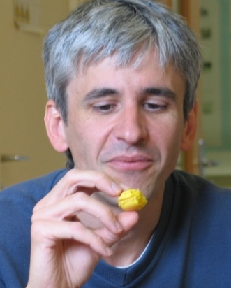
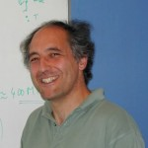
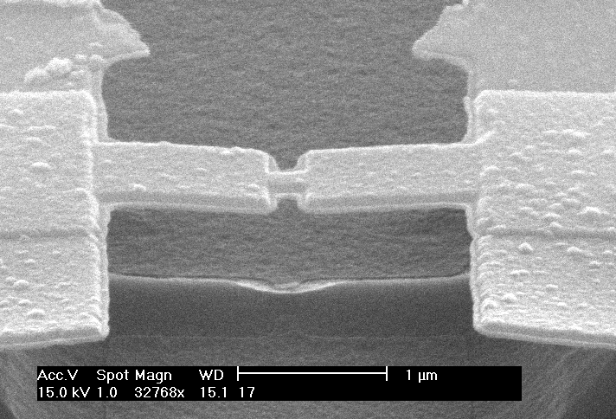
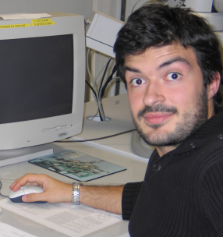

Quasiparticle Trapping in Andreev Bound States
Maciej Zgirski*, L. Bretheau, Q. Le Masne, H. Pothier, C. Urbina, D. Esteve
Quantronics Group, SPEC, CEA Saclay, France
*presently: Institute of Physics, PAN, Warsaw
L. Bretheau
D. Esteve
H. Pothier
Q. Le Masne
C. Urbina
PRL ,106, 257003 (2011)

Slide 3
MOTIVATION
Josephson effect in superconducting weak links – unified approach
Spectroscopy
of Andreev Levels
Andreev Qubit
τ
S
S
S
I
S
E(δ)
+Δ
+E_{A}
0
δ
-Δ
-E_{A}

Slide 4
ANDREEV REFLECTION
COUPLING OF eh AND h$
N-S interface
N
S

Slide 5
PHASE-BIASED SHORT, Ballistic
SINGLE CHANNEL
L < ξ
τ =1
φ_{L}
φ_{R}
Fabry-Perot resonator

Slide 6
ANDREEV BOUND STATES
in a short ballistic channel (τ =1 )
E
τ = 1
Andreev spectrum
E(δ)
φ_{L}
φ_{R}
+Δ
+Δ
E→
0
δ
0
π
2π
-Δ
E←
-Δ
2 resonances

Slide 7
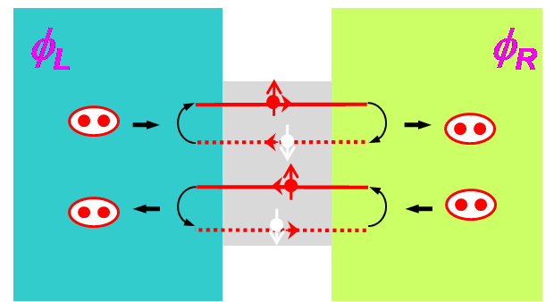
ANDREEV BOUND STATES
in a short reflective channel (τ <1 )
E
τ < 1
Andreev spectrum
+Δ
E(δ)
+Δ
+E_{A}
0
0
δ
-Δ
-Δ
-E_{A}
Furusaki, Tsukada
C.W.J. Beenakker (1991)
Central prediction of the mesoscopic theory
of the Josephson effect

Slide 8
SUPERCONDUCTING WEAK LINKS
Weak link = ensamble of independent transmitting channels,
each characterized by transmission τ (Landauer picture)
N – number of transmission channels
τ - transmission
Tunnel junction:
N→ infinity
τ ->0
Atomic contact:
N ~ 1
0 < τ < 1
τ
S
S
S
I
S
γ = γL - γR
Current phase-relation
Iac(δ) = ?

Slide 9
FROM ANDREEV BOUND STATES
TO SUPERCURRENT
E(δ)
+Δ
+E_{A}
Ground state :
0
δ
-Δ
-E_{A}
Current-phase relation

Slide 10
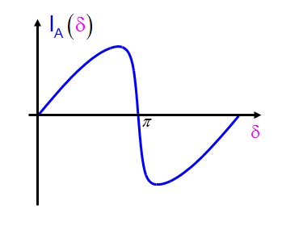
Current – phase relation…
E(δ)
+Δ
0
δ
-Δ
…is a probe of a configuration
of Andreev bound states

Slide 11
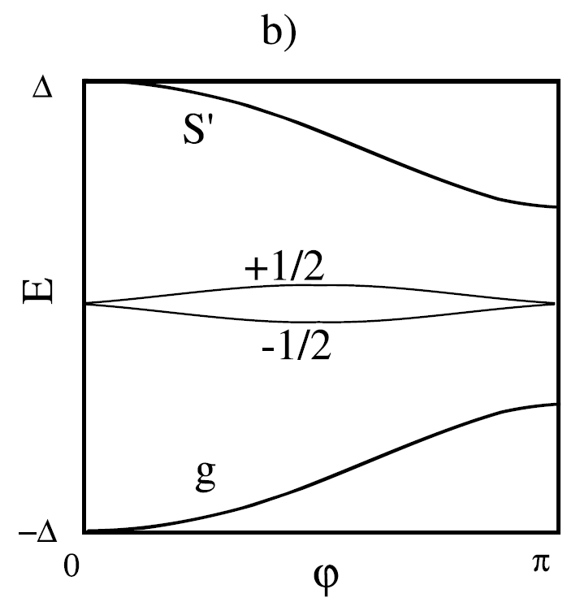
Towards ANDREEV QUBITS
E(δ)
+Δ
+E_{A}
0
δ
-Δ
-E_{A}
Use even states
Use quasiparticle (spin ½) states
Zazunov, Shumeiko,Bratus’, Lantz and Wendin, PRL (2003)
Chtchelkatchev and Nazarov, PRL (2003)

Slide 12
ATOMIC CONTACT = SIMPLEST WEAK LINK fabrication & characterization
I
V
S
S
1 atom contact = few conduction channels (Al: 3)
Stable system
Can be completely characterized

Slide 13
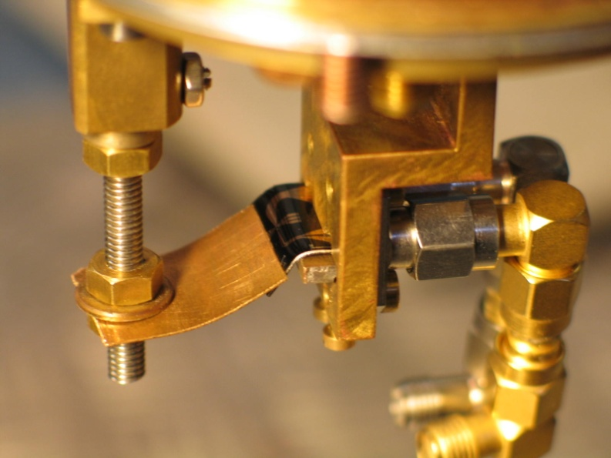
MICROFABRICATED BREAK-JUNCTIONS
metallic film
pushing
rods
Flexible
substrate
insulating
layer
counter-
support

Slide 14
PIN code of the atomic contact
Scheer et al. PRL 1997

Slide 15
Current bias in not enough…

Slide 16
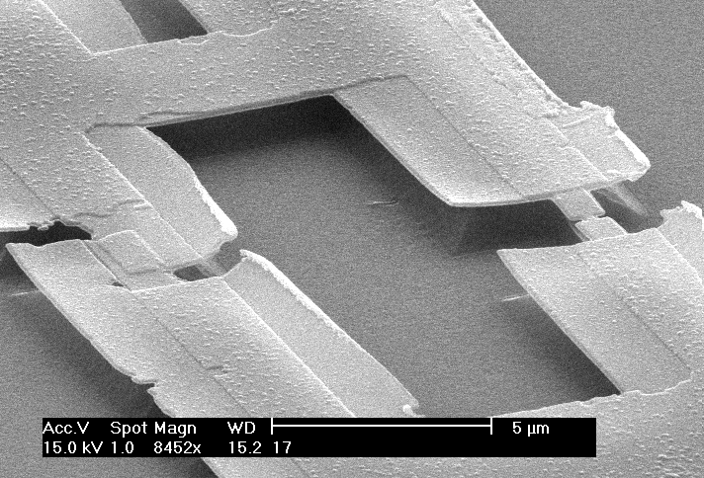
Atomic Squid…
I_{AC}
or
V

Slide 17
…allows to determine channels transmissions…
measurement
OPEN
V
I_{b}
I
transmissions {τ_{i}}

Slide 18
…and impose phase on atomic contact
measurement
γ
I_{b}
I_{JJ} >> I_{AC}
“Strength” of the weak link
~ critical current
SHORT

Slide 19
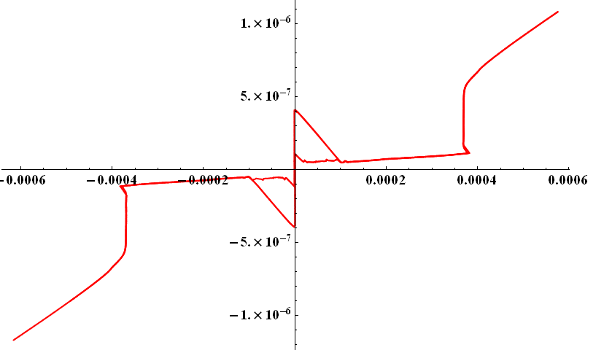
Switching of the Atomic Squid
Ib
switching
V
retrapping
I_{AC}
or
δ
γ

Slide 20
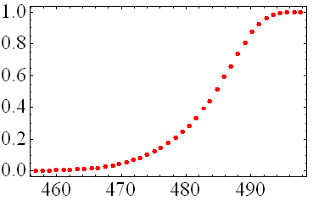
SWITCHING MEASUREMENTS
I_{b} (nA)
Supercurrent branch
<I_{sw}>
V (µV)
I_{b} Pulse height
« s curve »
P
t_{p}
T_{r}
time
N
V
Switching probability
time
n
usually
T_{r}=20µs
t_{p}=1µs
N=5000
I_{b} (nA)

Slide 21
Flux Modulation pattern for ATOMIC SQUID
= I(δ) of the atomic contact
I0-switching current
of junction alone
When SQUID switches, phase across JJ is approx. the same independently of applied magnetic flux => interference pattern is current-phase relation of atomic contact
The ground Andreev state is well-known…
Theses in Quantronics:
M. Chauvin,
B. Huard,
Q. Le Masne
Della Rocca et al., PRL 2007

Slide 22
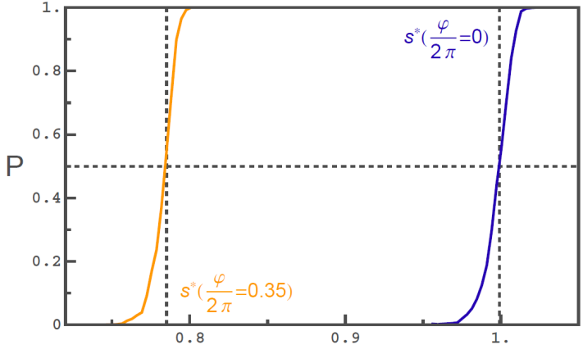
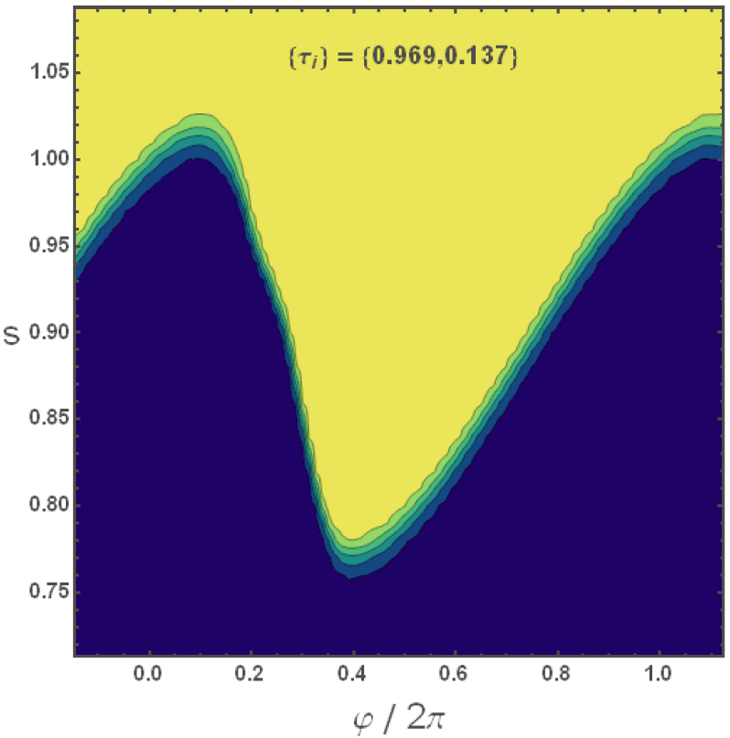


Switching probability map with normal leads
P (I_{b},ϕ)
P
1
P = 1
A vertical cut is an s-curve
s = I_{b}/I₀
I₀ - critical current of JJ alone
P = 0
0

Slide 23
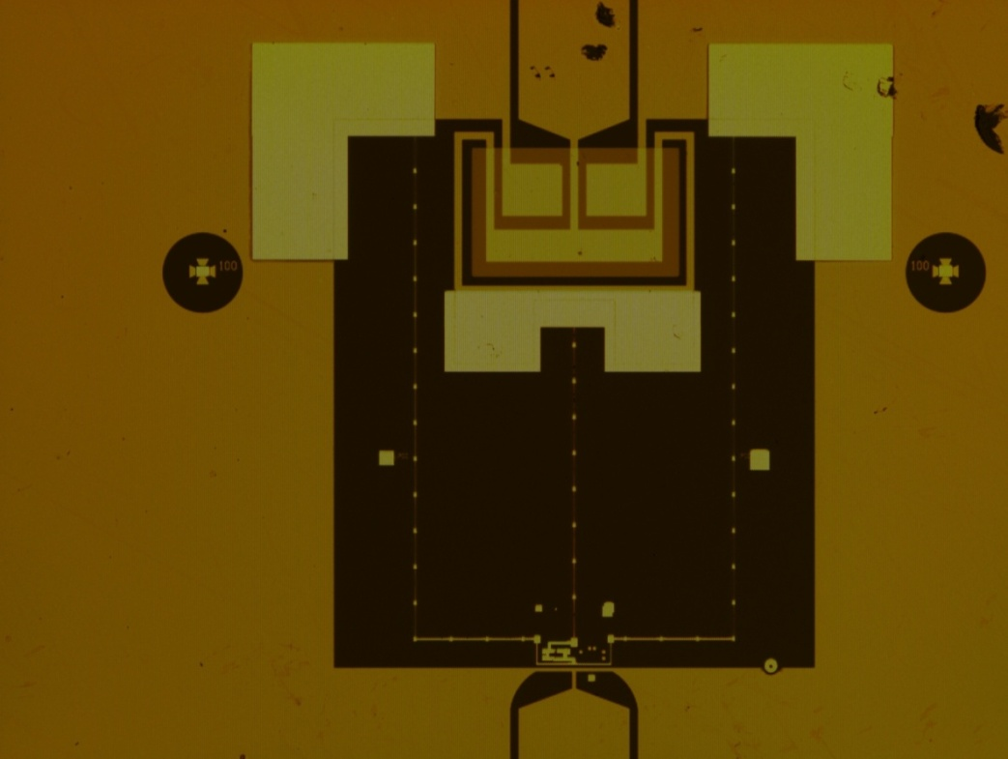
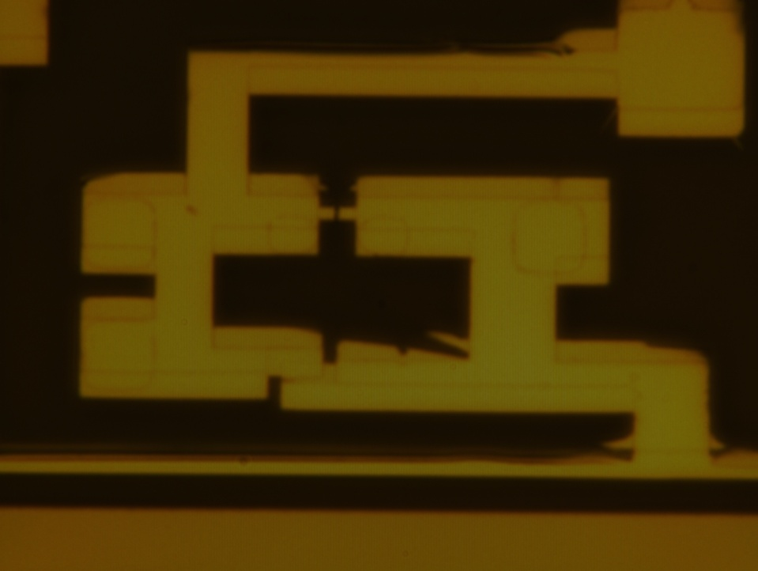
SAMPLE

Slide 24
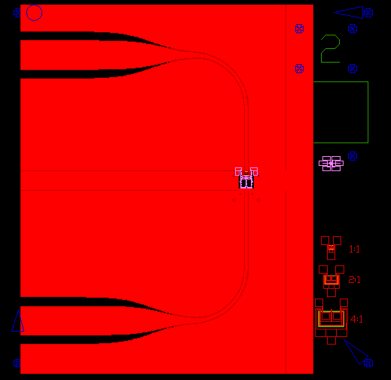
Sample design
bias line
e-beam lithography
designed to be 50Ω
at T < 1K
antenna

Slide 25
Switching probability map
with superconducting electrodes
T=40mK,
Period= 20µs
t_{p}
T_{r}
time
τ={0.95, 0.445, 0.097}
N
j₁
j₂
Height of plateau is period dependent => some relaxation going on in the system
Notes:
As we increase dead time between pulses plateau gets higher meaning higher probability of finding our contact in the ground state. It suggests that there is some relaxation going in the system. So we are in ground state or in an another state with different probability dependent on dead time between pulses. To avoid playing with conditional probabilities and test the system always in statistically the same state we use prepulse to erase memory and prepare system in the statistically same state (= definite probability of being in the ground state just after switching).

Slide 26
Switching curve with prepulse
{0.95, 0.45 , 0.10}
Erase memory of the previous history before
each measurement:
P₁(I_{b})
pP₁(I_{b})+(1-p)P₂(I_{b})
1.3
~ 0.1µs
1
1μs
P₂(I_{b})
0
{0.45 , 0.10}
delay
« prepulse »
After switching, system is where we expect it to be with probability p

Slide 27
Blocking the most transmitting channel
{0.45 , 0.10}
{0.95 , 0.45 , 0.10}

Slide 28
QUASIPARTICLES IN A SUPERCONDUCTING
POINT CONTACT
E
Δ
E_{A}
0
-E_{A}
-Δ
Ground state
1-qp states
2 qps
E(δ)
+Δ
0
δ
-Δ

Slide 29
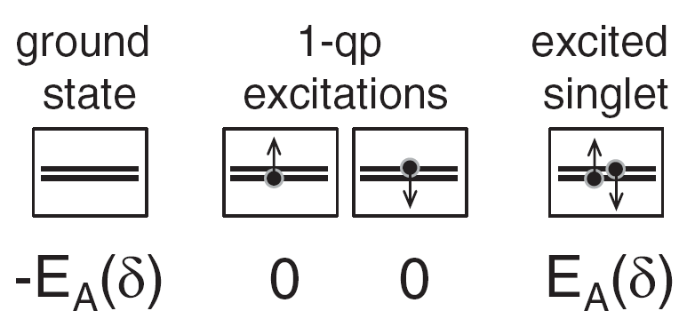
Excitation picture
All electrons paired
The smallest excitation
breaking parity
= one unpaired quasiparticle
Excited Cooper pair

Slide 30
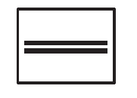
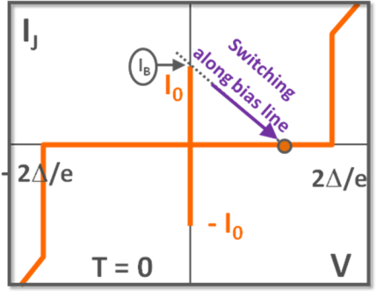
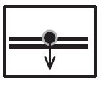
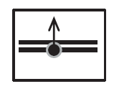
Two scenarios
Initial state
QP
n_{QP}
1.
Weight = p
E
Channel switched on
n_{QP}
2.
Weight = 1 - p
Channel switched off
E
Switching probability is the weighted average of these 2 scenarios.

Slide 31
Modulation curves on different contacts
{1,0.072,0.072}
AC1
{0.998,0.56,0.124}
AC2
{1,0.7,0.24,0.24,0.06}
AC3
The most transmitting channel is sometimes switched off

Slide 32
1QP STATE RELAXATION MEASUREMENTS
I_{b}
Current line
0
ϕ_{w}
waiting time
δ
Phase across contact
Flux line
ϕ_{i}
δ_{i}
TR(δ)
P_{inf}(δ)

Slide 33
A few 100μs relaxation time
{1,0.07,0.07}
T=29mK
-0.6π 0 0.6π
δ phase across atomic contact
Symmetry around π
Monotonous behaviour

Slide 34
Relaxation as a function of phase across Atomic Contact for different transmissions
T=29mK

Slide 35
Energy threshold for relaxation
E(δ)
+Δ
0
π
2π
δ
-Δ
E₋
Relaxation instantaneous only for Andreev Bound states with energies bigger than
0.5 Δ ~25GHz ~1K

Slide 36

Energy threshold for relaxation
n_{QP}
E
n_{QP}
Δ
E
Δ/2
WHY?

Slide 37
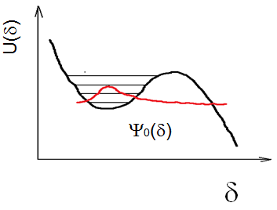
Possible explanation
hν
n_{QP}
E
hν ~ Δ/2
n_{QP}
Δ
E
Δ/2

Slide 38
Conclusions
Atomic contacts with tunable transmissions
Atomic Squid to measure current-phase relation of atomic contact with switching measurements - for ground Andreev bound states excellent agreement with theory
Quasiparticle poisoning => disappearence of the most transmitting channel;
long relaxation for Andreev Cooper pair binding energies smaller than 0.5Δ, sharp cut off for binding energies bigger than 0.5Δ (?)
Dispersive measurements of resonant frequency of resonator + atomic squid
Trials to observe avoided level crossing (atomic contact embedded in resonator)
No evidence of excited Andreev state in 2 different experiments (switching measurements, coupling to resonator )
Current Status: Josephson Junction spectroscopy of Atomic Squid – observed avoided level crossing
PLASMA FREQUENCY – ANDREEV GAP

Slide 39
Temperature dependence
{1,0.07,0.07}

Slide 40
Does excited Andreev state exist?
(OPTIONAL)

Slide 41
Sample design
bias line
e-beam lithography
designed to be 50Ω
at T < 1K
antenna

Slide 42
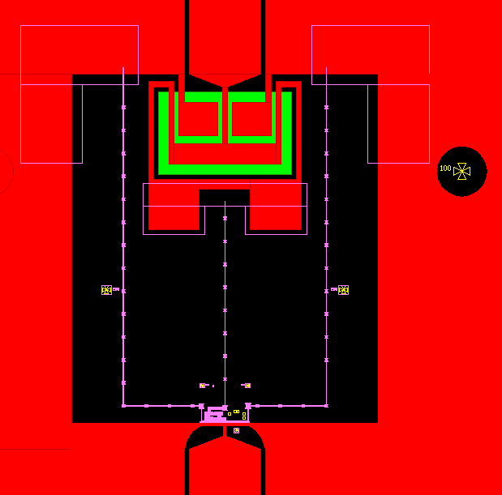
Capacitor + inductive lines
Andreevmon (or Andreevnium)
140µm
10µm gap
Capacitor C = 60 pF
680µm
inductive lines, 900nm wide, 70 + 54 nm thick Al
Ltotal = 1.8nH
antenna (5µm wide short of CPW)

Slide 43
Electromagnetic environment is important
δ
I_{B}
L
R
RF line
γ
V_{B}
bias line

Slide 44
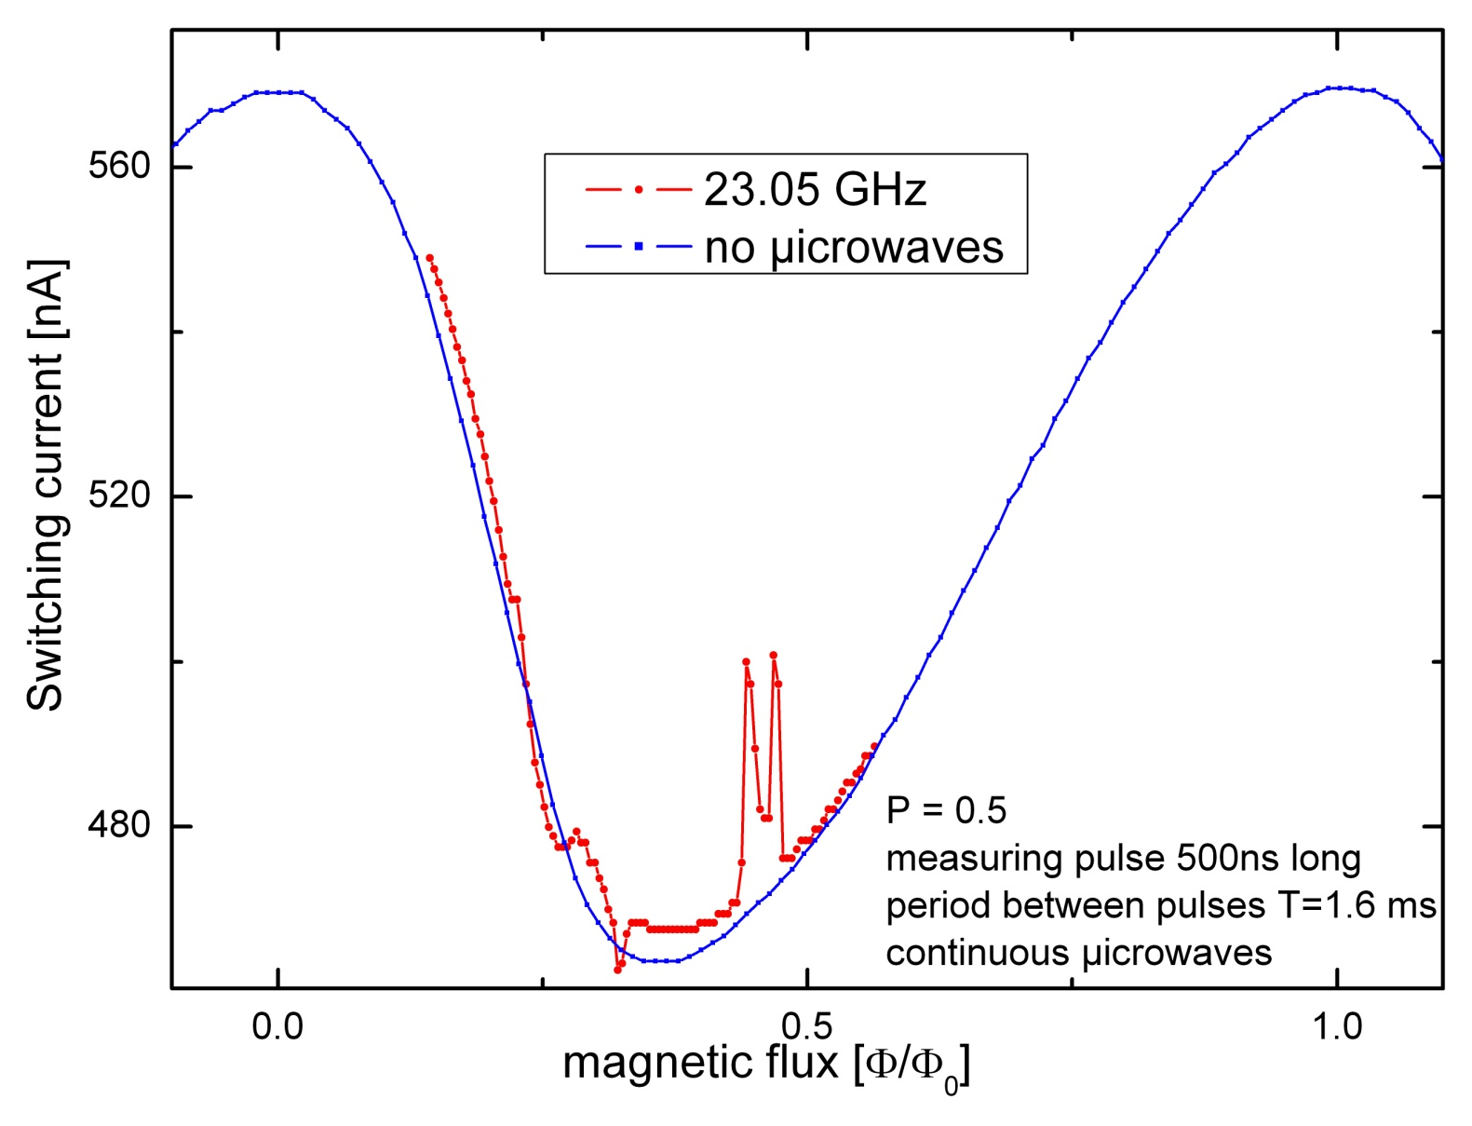
Trials to observe excited Andreev state
Expected
Peak position is frequency-dependent
I
0
0.5
1
δ / 2π

Slide 45
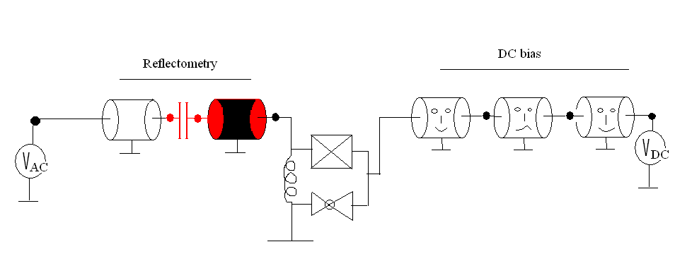
Andreev Qubit in cavity
Weak coupling

Slide 46
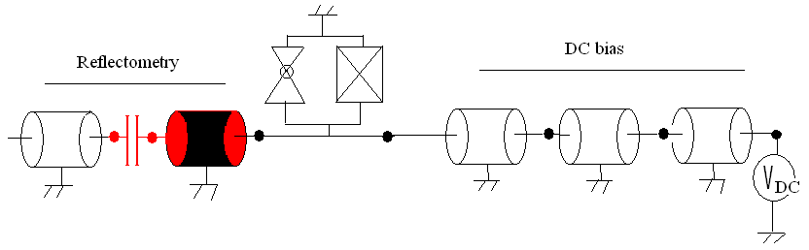
Cavity Quantum Electrodynamics
V_{AC} ^{in}
V_{AC} ^{out}
strong coupling regime

Slide 47
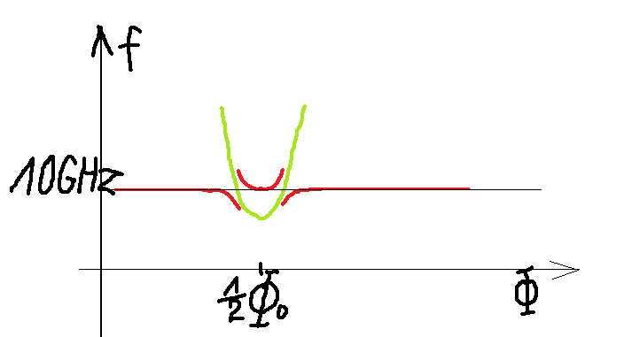
Let 2 level system interact with resonator
Andreev Gap
Bare Resonator eigenfrequency
Red – expected position of resonance
Interaction “off”
Interaction “on”
avoided level crossing
Coherent exchange of energy between resonator and artificial atom

Slide 48
2 CHANNELS POISONING
{0.95, 0.94, 0.60, 0.34, 0.30, 0.29, 0.27, 0.26, 0.24, 0.2}

Slide 49
Pollution of 2 channels
{0.957, 0.948, 0.601, 0.344, 0.295, 0.291, 0.27, 0.262, 0.242, 0.2}
1 channel blocked
2 channels blocked
All channels

Slide 50
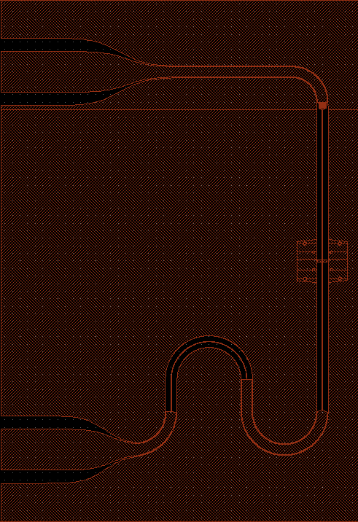
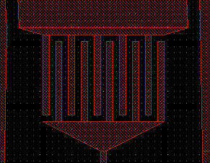
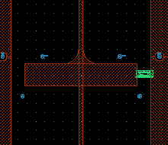
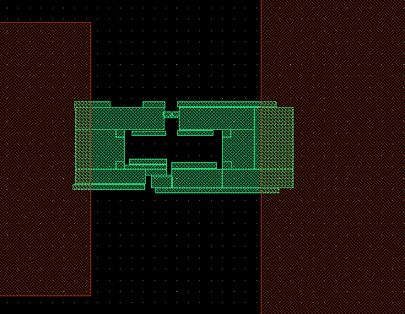
Atomic SQUID in cavity

Slide 51
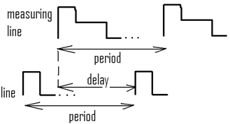
Flux pulse cleans excited Andreev state
Current line
period
RF line
Flux line
delay
V_{flux}
big enough
period

Slide 52
MULTIPLE CHARGE TRANSFER PROCESSES
I
V
S
S
τ
Blonder, Tinkham, Klapwijk (‘82)
2Δ / 3
2Δ / 2
2Δ / 1

Slide 53
Atomic contact
53/19
S
S
few channels, {τ_{i}} tunable
Al film
Δx
counter-support
{τ_{i}} measurable
pushing rod
Δz
Elastic substrate

Slide 54
QUASIPARTICLES IN A BULK SUPERCONDUCTOR
E
Δ
0
-Δ
Ground state
1-qp states
2 qps

Slide 55
QUASIPARTICLES AND SUPERCURRENT IN A SUPERCONDUCTING POINT CONTACT
Ground state
Lowest-lying 1-qp excitations
1-qp state
Excited singlet
E(δ)
+Δ
0
δ
-Δ

Slide 56
correlated switching events
V(t)
➔ Need a ‘’reset’’ between pulses

Slide 57
MEASURING THE SWITCHING PROBABILITY
meas^{t}
hold
1µs
V_{b}(t)/R_{b}
sI₀
V(t)

Slide 58
MEASURING THE SWITCHING PROBABILITY
prepulse (reset)
meas^{t}
hold
1µs
1.3 sI₀
V_{b}(t)/R_{b}
sI₀
Δt
V(t)
➔ Uncorrelated switching events

Slide 59
Reaching 1QP odd state
2QP state
for Al
1QP state (x2)
Ground state
QP
n_{QP}
E

Slide 60
RELAXATION VERSUS ANDREEV ENERGY

